Slide 1
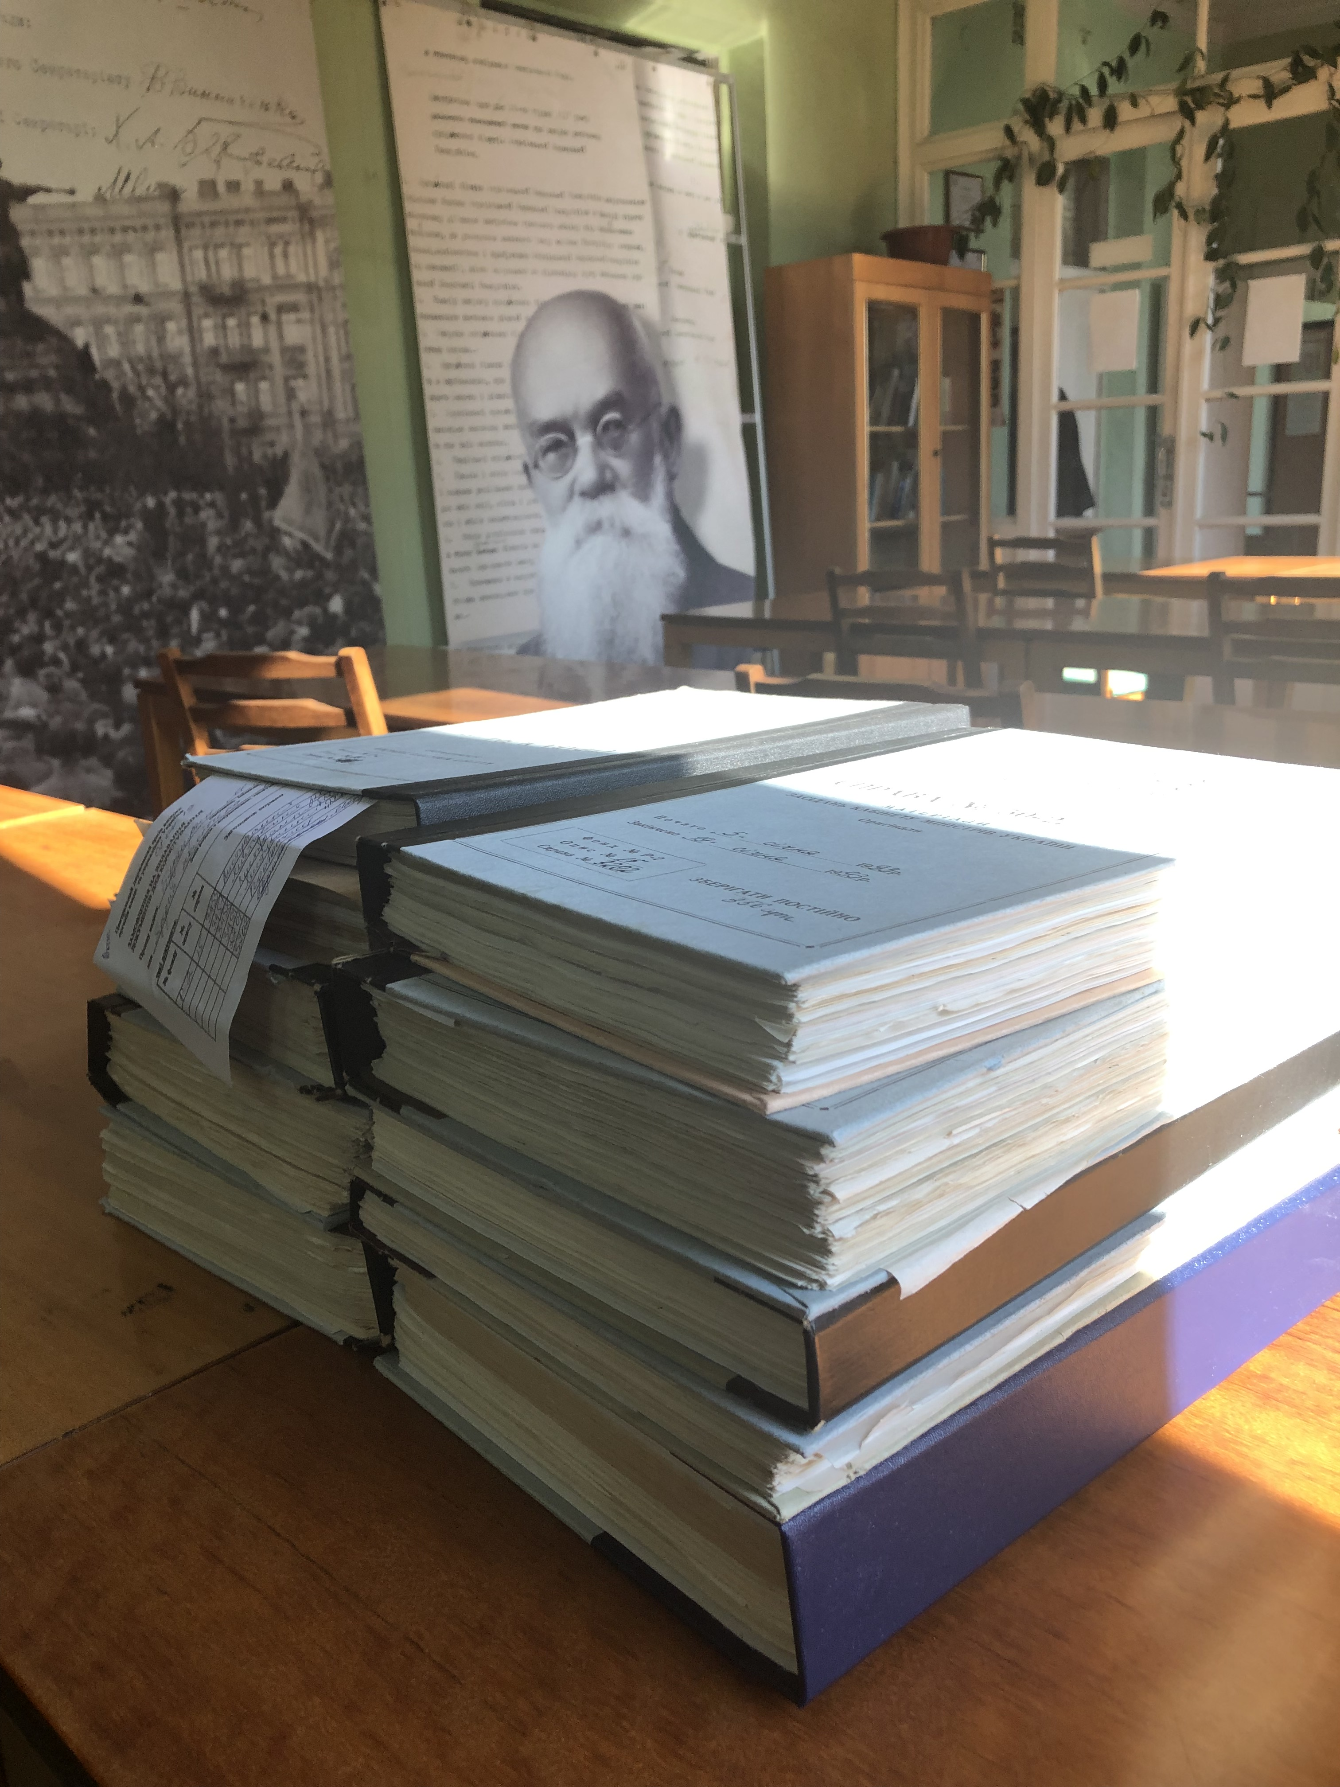
Ukrainian Archives
For Researchers in Soviet and Post-Soviet Politics and Security
Mariana Budjeryn
Harvard Kennedy School
For National Security Archive
Washington, D.C.
July 2020

Slide 2
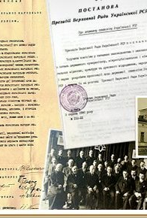
Central State Archives of Supreme Authorities and Governments of Ukraine
Holdings:
  Government agencies of the Ukrainian Soviet Socialist Republic (1917-1991)
  Ukrainian republics and revolutions (1917-1921)
  Government agencies of independent Ukraine (1991-2001)
Selected Collections (Фонди/’Fond’):
  Fond 1/1-P: Verkhovna Rada of UkrSSR/Ukraine (1917-2017)
  Fond 2: Cabinet of Ministers of Ukraine (1918-2003)
  Fond 5233: Administration of the President of Ukraine (1991-1997)
Special project to ease access to documents on repressive apparatus of the Soviet regime (1917-1991)

Slide 3
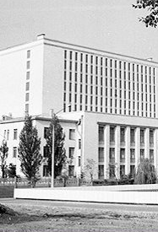
Central State Archives of Supreme Authorities and Governments of Ukraine
Located on 24 Solomyanska St, Kyiv, Ukraine
  http://tsdavo.gov.ua/
  Online searchable finding aids, in Ukrainian
Access:
  No need to reserve the reading room in advance
  Bring a valid ID/passport
  Plan to spend your first day browsing finding aids and filling out request forms
  Allow 2-3 business days between request and access to files
  Only 10 folders can be accessed in a day
  Laptops and photographing allowed
  Rules can change, check in advance +38 (044) 275-36-66
  tsdavo@arch.gov.ua

Slide 4
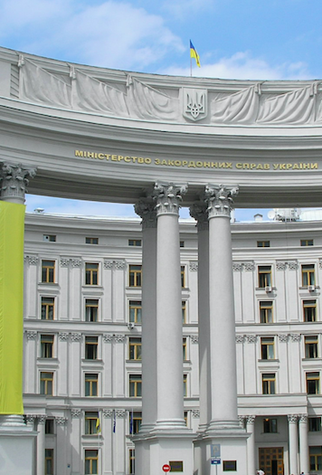
Archive of the Ministry of Foreign Affairs of Ukraine
Holdings:
  All documents relating to the office of the Minister, various department, diplomatic correspondence, analytical materials for the president and the Rada, etc (1945? – present?)
Access:
  Located on 1 Mykhailivska Sq, Kyiv, Ukraine, in the building of the Ministry
  Inquire about an appointment well in advance
    Archival Department Director Larysa Degteriova
    +38 (044) 238 16 49, 214@mfa.gov.ua
  May need to send an official letter from your institution/supervisor describing your project and materials you seek
  Bring in an ID/passport for processing a temporary access card
  May have limitations on bringing in a laptop
  Rules about photographing are uncertain
  Access might have tightened since 2014

Slide 5
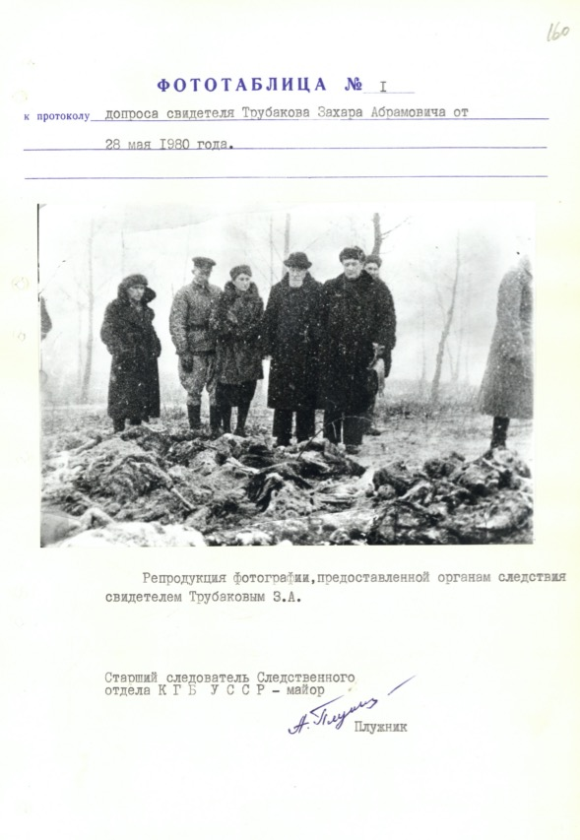
Archive of the Security Service of Ukraine (KGB Archive)
Holdings:
  Archives of the Ukrainian branch of the NKVD/KGB (1918-1991)
    Ukrainian revolutions (1917-1922)
    Purges and the Holodomor
    WWII and insurgency
    Post-WWII dissident movement
    Chernobyl (a new 2-volume compilation published in 2020)
Access:
  Located on 33 Volodymyrska st, Kyiv, Ukraine; regional branches
  https://ssu.gov.ua/haluzevyi-derzhavnyi-arkhiv
  +38 (044) 256-92-96, arhivsbu@ssu.gov.ua
  Finding aids in .pdf available at the website
  Some 25K documents digitalized in Electronic Archive of the Ukrainian Liberation Movement (1917-1991), avr.org.ua
  Call to make an appointment in the reading room

Slide 6
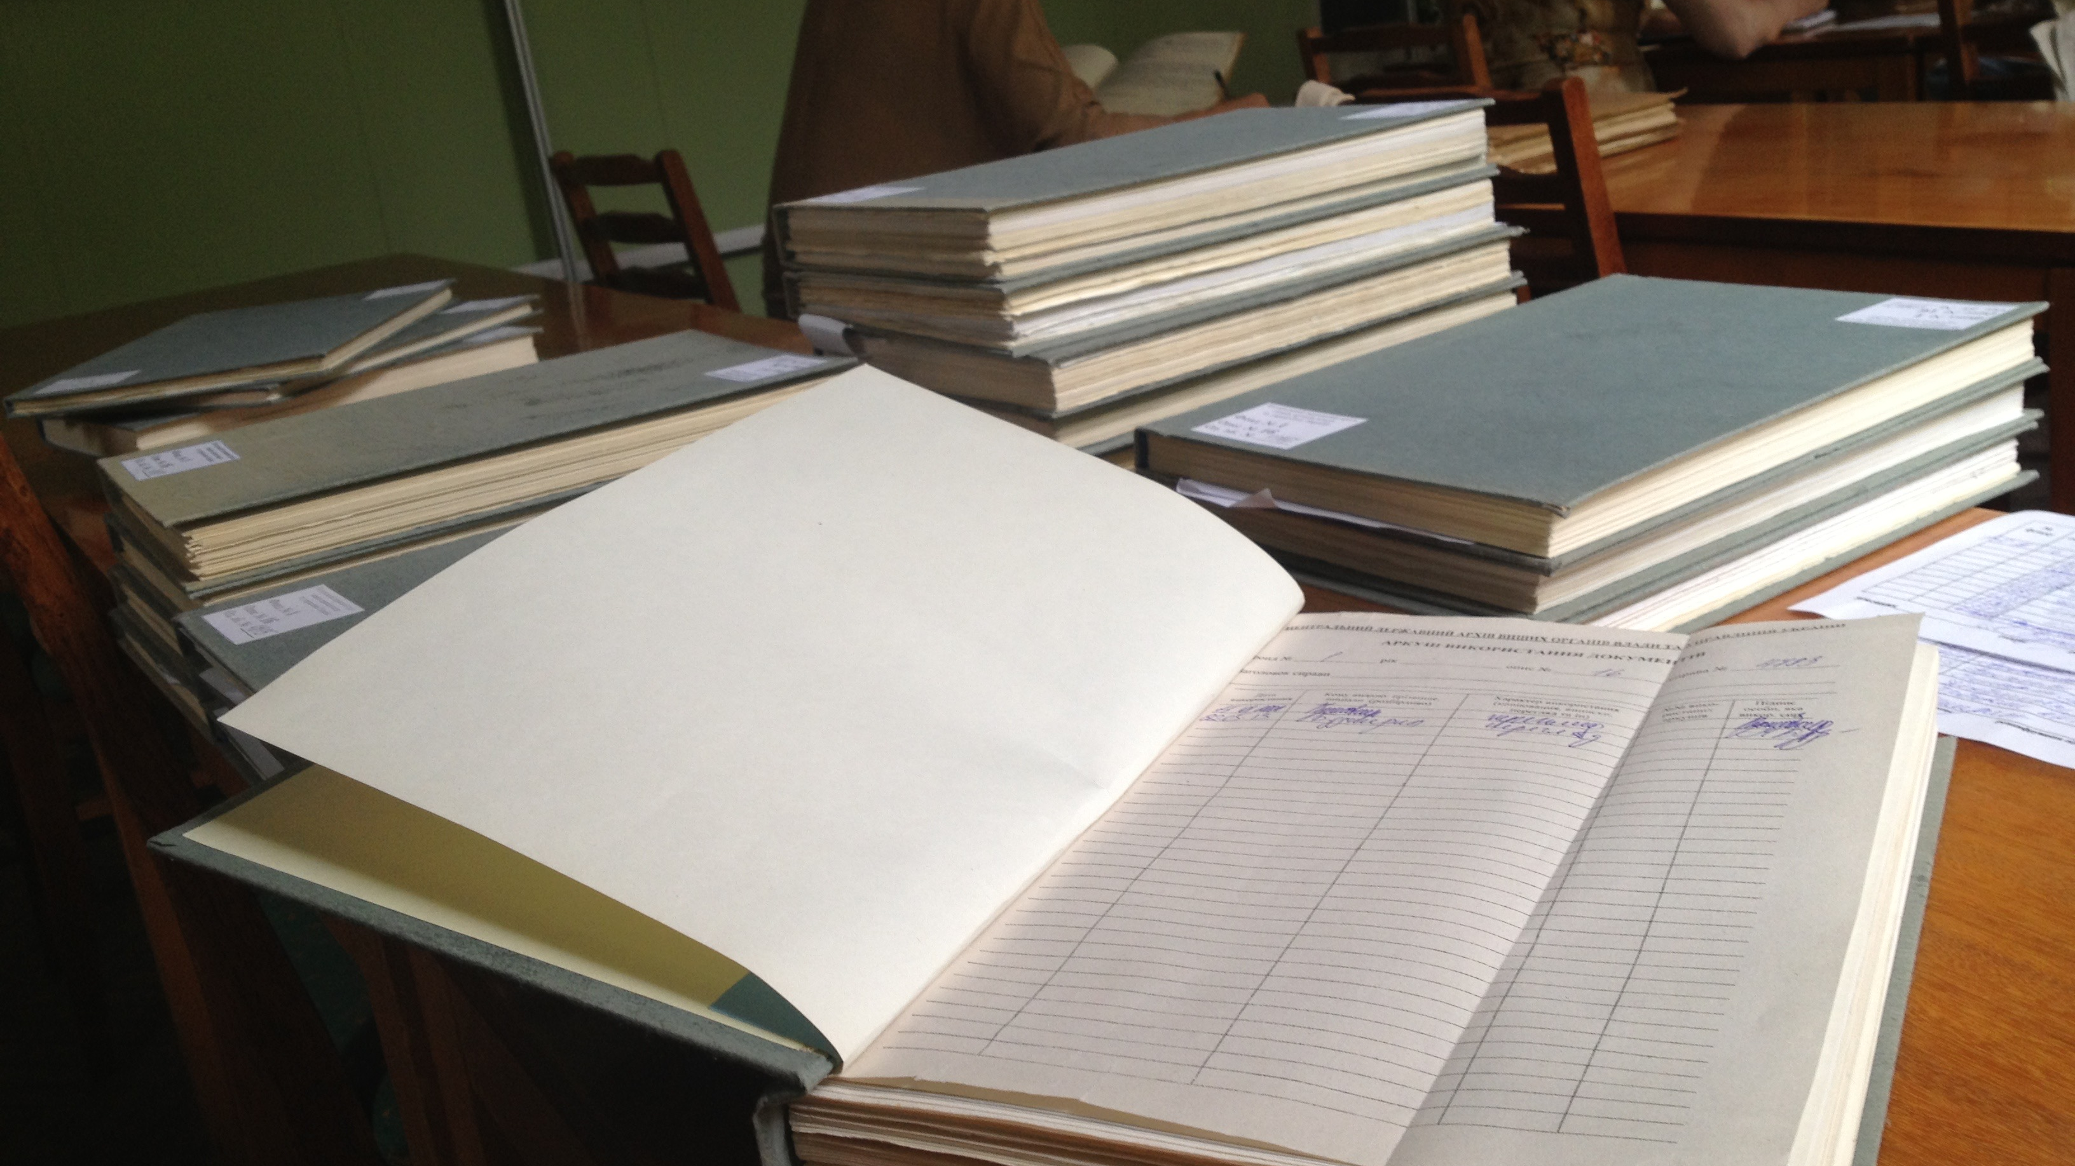
Thank you and good luck!
mariana_budjeryn@hks.harvard.edu

