Slide 1
Tambov Region’s Archives: Research Resource
Prof. Vladimir Dyachkov, prof. Vladimir Romanov,
Derzhavin Tambov State University (Russia)

Slide 2
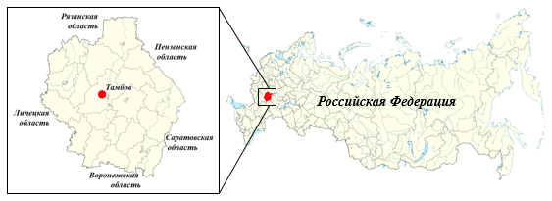
Tambov region is one of the subjects of Russian Federation, located in the Central Federal District.

Slide 3
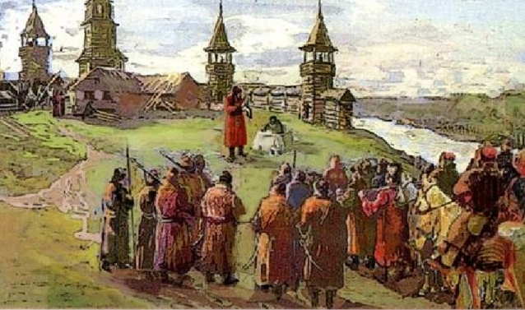
Tambov as a fortress was founded in 1636 to protect the southern borders of Russia from the raids of the Tatars.

Slide 4
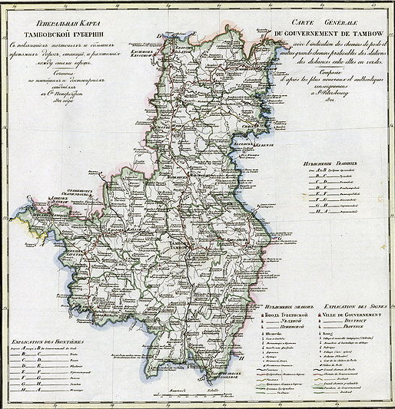
In 1779 Tambov became the administrative center of Tambov governorship.
By the beginning of the 19th c., Tambov province was one of the largest in European Russia in terms of area and population.

Slide 5
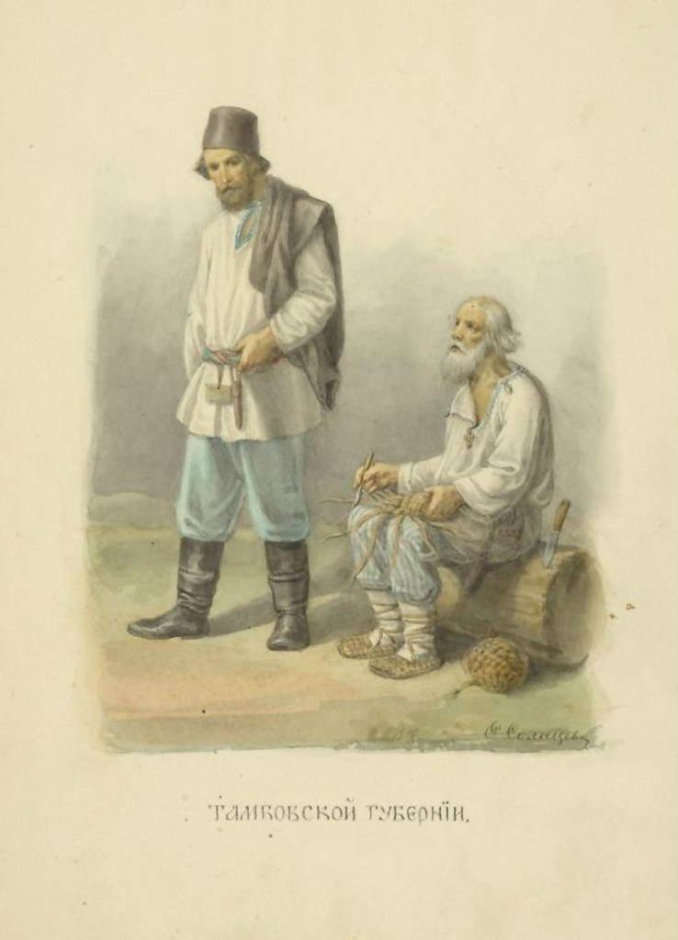
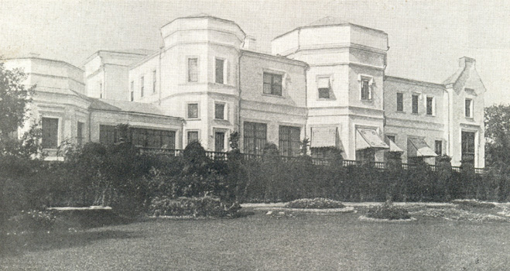
Tambov province was the traditional agrarian region of Russian Empire
The main house of the Chicherin’s manor, Karaul.
Tambov peasants

Slide 6
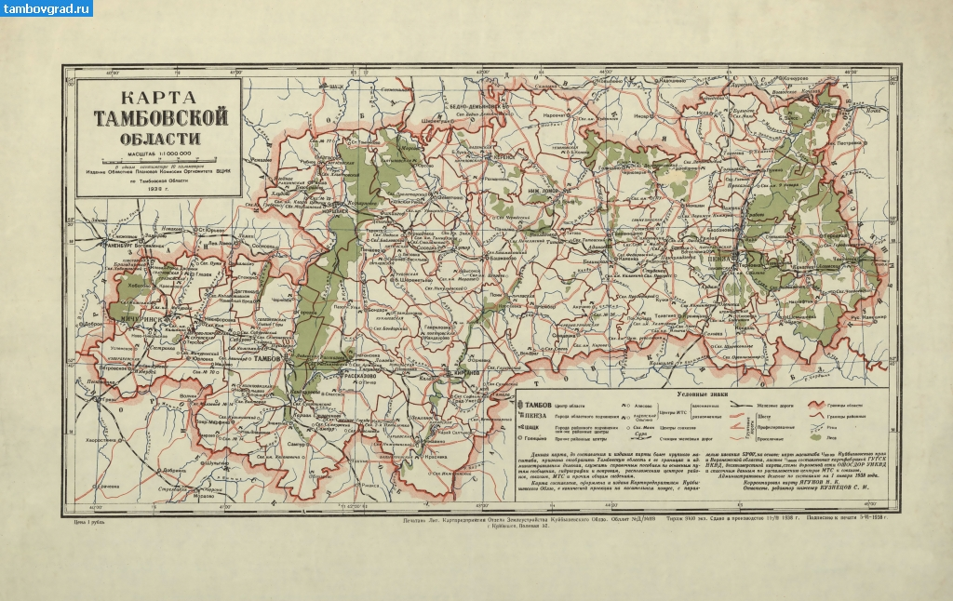
After the 1917 revolution, numerous territorial changes took place in Soviet Russia, and in 1934 Tambov region was restored as an independent administrative unit.

Slide 7
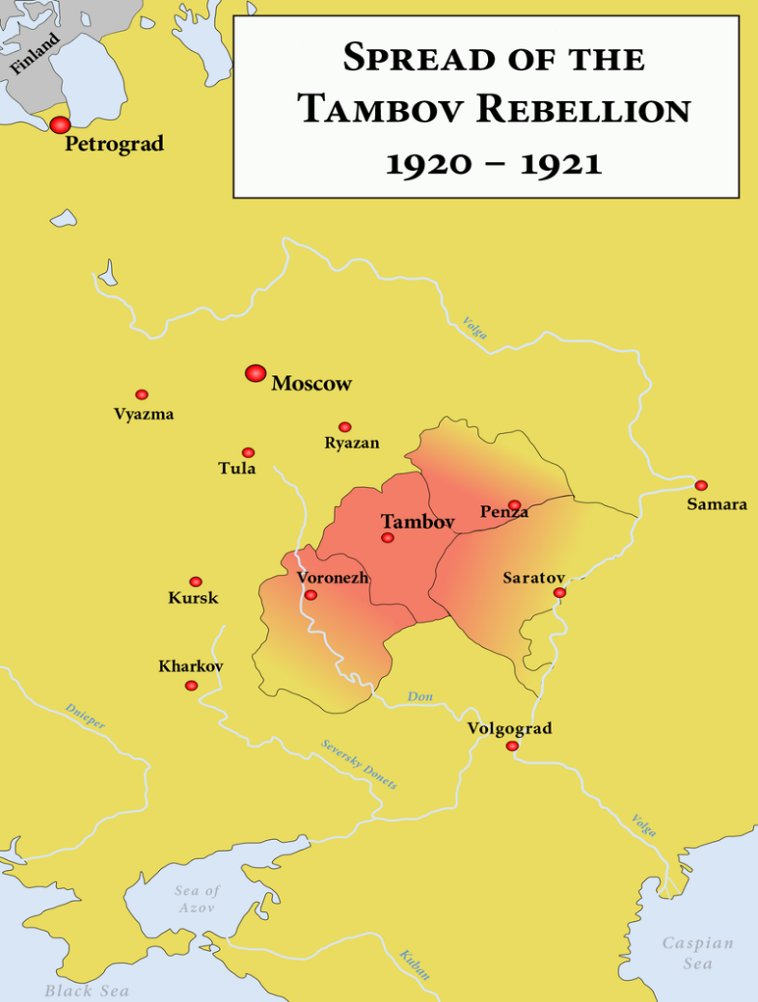
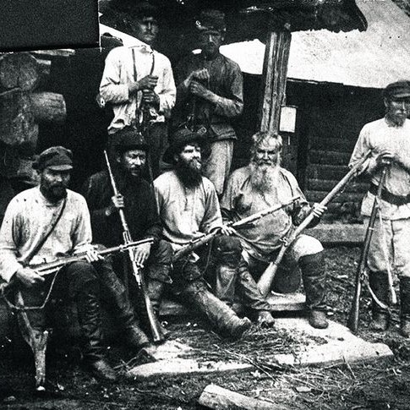
A well-known event of Russian civil war in Tambov region was the anti-Bolshevik peasant uprising “Antonovshchina” (1920-1921)

Slide 8
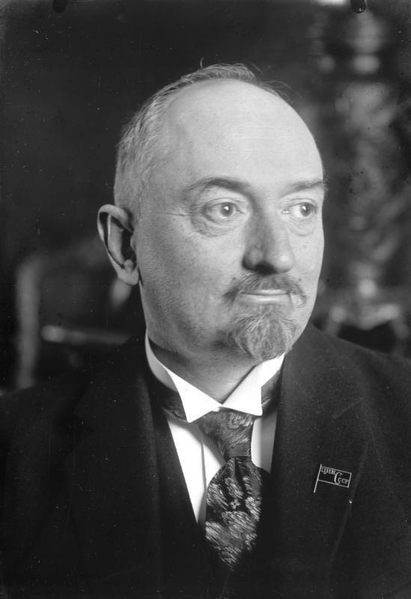
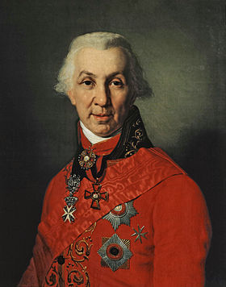
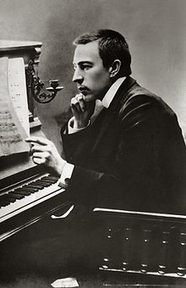
The history of Tambov region was associated with the names of prominent statesmen and representatives of Russian culture
Gavriil Derzhavin, poet,
Governor of Tambov (1786-1788)
Sergei Rachmaninov, composer,
lived for a long time in the Tambov estate Ivanovka
Georgy Chicherin, People's Commissar for Foreign Affairs in the Soviet government (1918-1930)

Slide 9
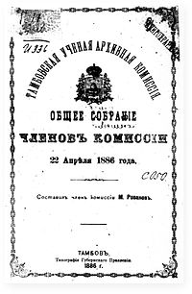
All periods of Tambov region’s history are reflected in the archive collections
The beginning of systematic archival activity was the work of Tambov Provincial Scientific Archive Commission, created in 1884.
This commission collected and systematized historical documents, concentrating them in a single archives. For this purpose, the archives of local institutions were sorted out, documents from private archives were examined.

Slide 10
In 1918-1919 this archive collection was transferred to the newly created Tambov provincial archives.
During World War II main materials from Tambov archives were evacuated.
Now Tambov archive collection is one of the largest collection of the Central Federal District in terms of the composition and content of documents.
The preserved archival documents reflect not only Tambov history but also the all-Russian history since the 17th c. till the 21st c.

Slide 11
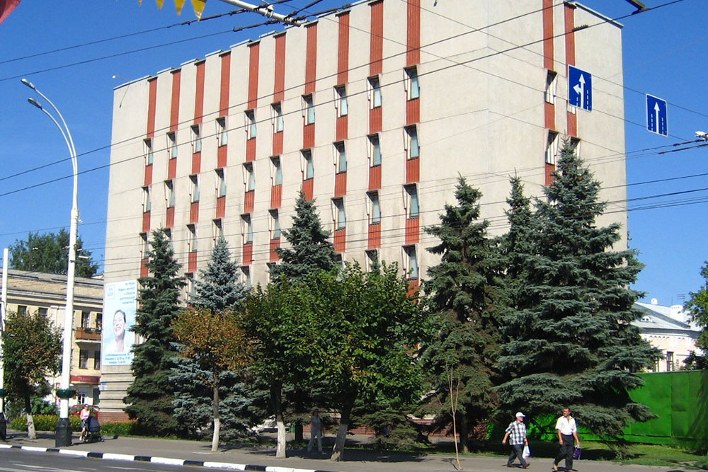
The State Archive of Tambov Region: https://tambovarchiv.ru/ more than 3.9 thousand funds containing over 1.3 million files

Slide 12
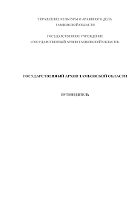
Guide to the State Archive of Tambov Region https://tambovarchiv.ru/sites/default/files/file-page/putevoditel-gato.pdf
Information about the composition and content of the funds of the Archives.
The documents of the foundations reflect the history of the political, socio-economic and cultural development of Tambov region from the second half of the 17th c. till the beginning of the 21st c.

Slide 13
The most important groups of documents:
Documents of local authorities and administration (1719-2005);
Bodies and court institutions, prosecutors and notaries (1764-1999);
Military institutions (1761-1948);
Statistical, financial and credit institutions (1779-2000);
Industrial management bodies, industrial enterprises and construction organizations (1832-2006);
Land surveying and land management institutions, agriculture, forestry and water management (1696-1992);

Slide 14
Communication institutions (1846-1990);
Institutions of science, culture and education (1609-2003);
Public health authorities (1799-2002);
Religious institutions (1636-1923);
Institutions Provisional government (1917-1918);
Public organizations (1864-1996);
Personal funds (1627-2006);
Photographic documents (1860-2001);
Soundtracks (1957-1999);
Video documents (1992-1997).

Slide 15
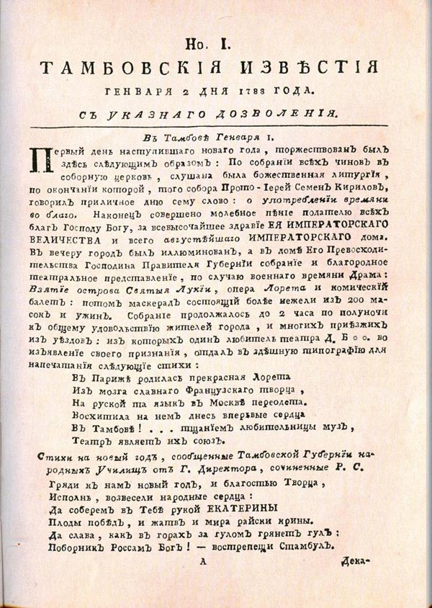
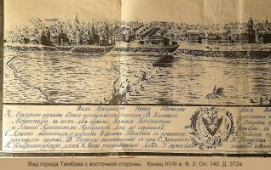
Some documentary online-collections
Exhibition of archival documents dedicated to the 240th anniversary of the formation of Tambov governorship
https://tambovarchiv.ru/node/229

Slide 16
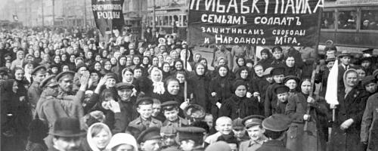
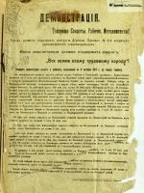
Tambov province between two revolutions: February 1917 - March 1918
https://tambovarchiv.ru/node/180

Slide 17
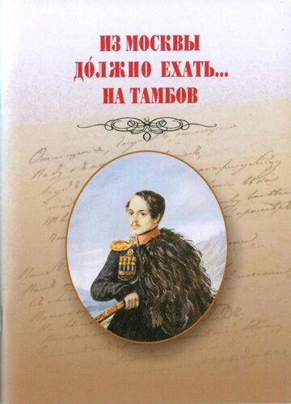
Some publications of archive collections
“From Moscow must go ... to Tambov”
https://tambovarchiv.ru/sites/default/files/file-book/iz-moskvi-dolgno-ehat-na-tambov.pdf
Materials on the ties of Russian poet Mikhail Lermontov with Tambov, reflected in memoirs and archival documents.

Slide 18
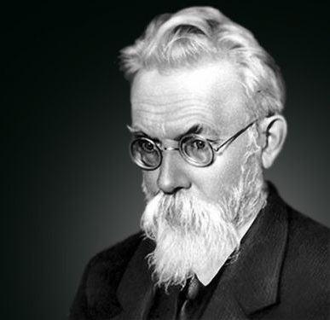
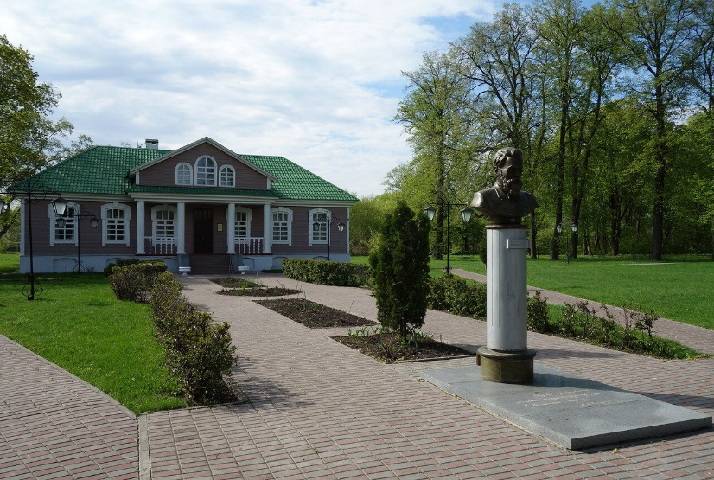
Vladimir Vernadsky in Tambov Province. https://docs.google.com/viewer?url=https://tambovarchiv.ru/sites/default/files/file-book/vernadskii-v-tk.pdf
Description of the most valuable documents from the main funds – Morshansk district and provincial Zemstvo assemblies, the personal fund of Vladimir Vernadsky (1863-1945), famous Russian scientist and Tambov public figure

Slide 19
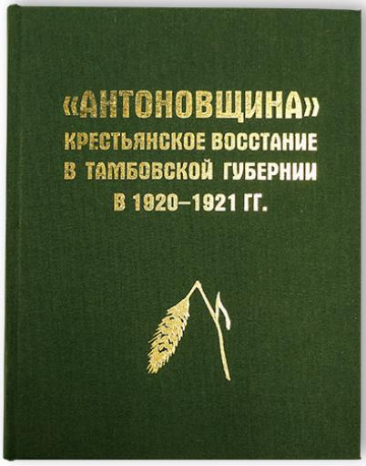
“Antonovshchina”: Peasant uprising in Tambov province in 1920-1921
The most complete collection – some 700 archive documents.
This publication contains documents of rebels and the Bolshevik formations on the history of the anti-Bolshevik uprising.

Slide 20
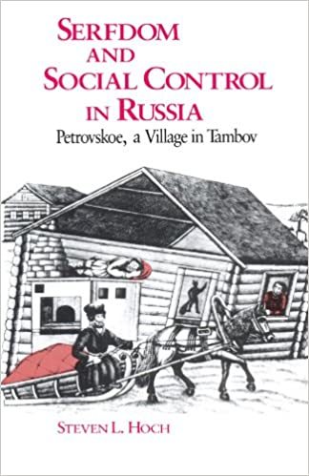
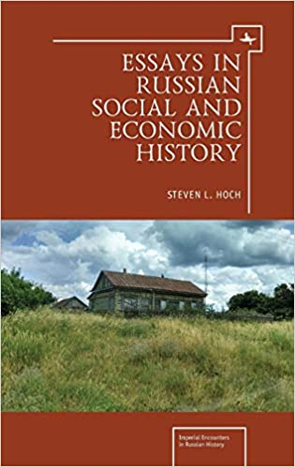

The results of archive research in Tambov have been reflected in publications of a number of foreign historians
Steven L. Hoch, Professor of History at Washington State University

Slide 21
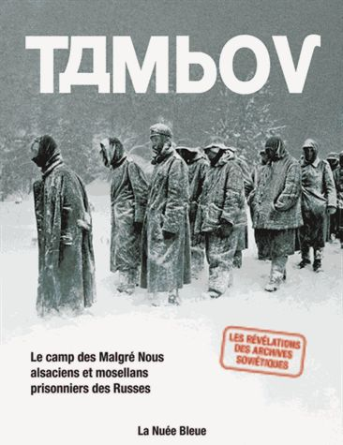
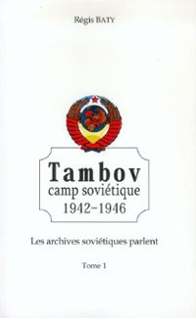
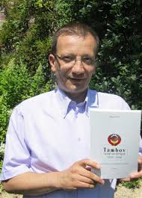
Regis Baty, professor of history at Strasbourg University

Slide 22
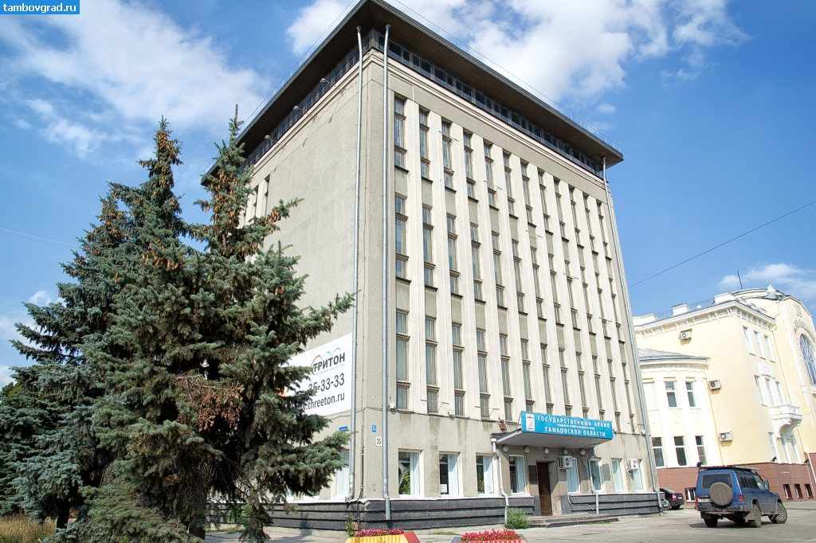
The State Archives on Social-Political History of Tambov Region: http://gaspito.ru/
5578 funds containing 810429 files (01.01.2020):
The CPSU and other political “paper” documents;
Files of personal origin, including letters, diaries, photos and memoirs;
Periodicals and books;
Photo, video, phono, CD files.

Slide 23
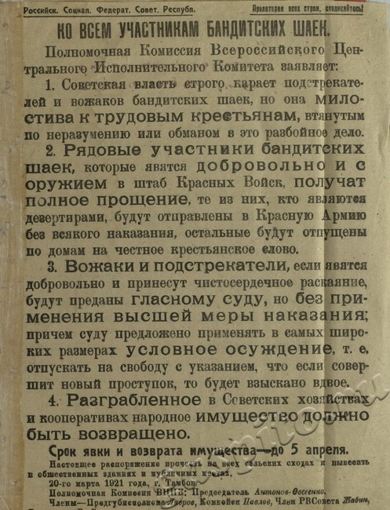
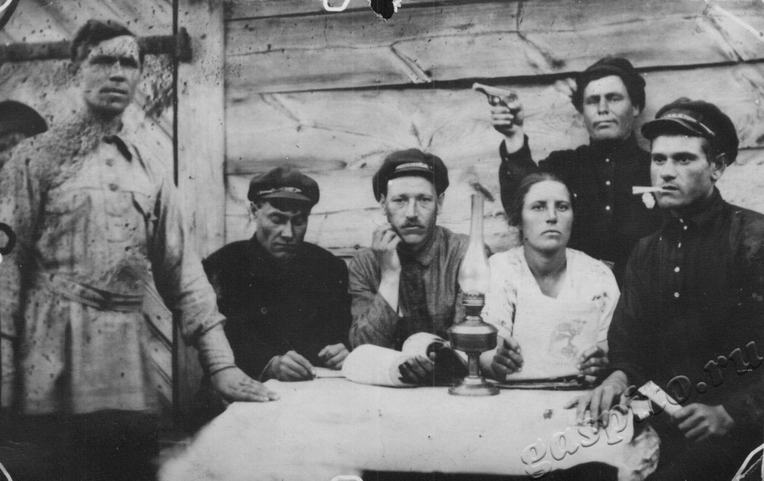
The Bolshevik appeal to the peasant rebels, 1921
In times of collectivization, 1929

Slide 24
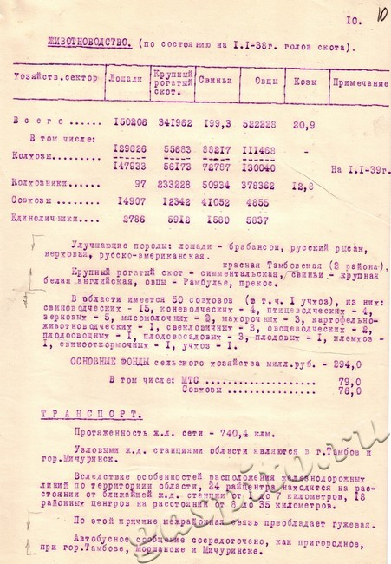
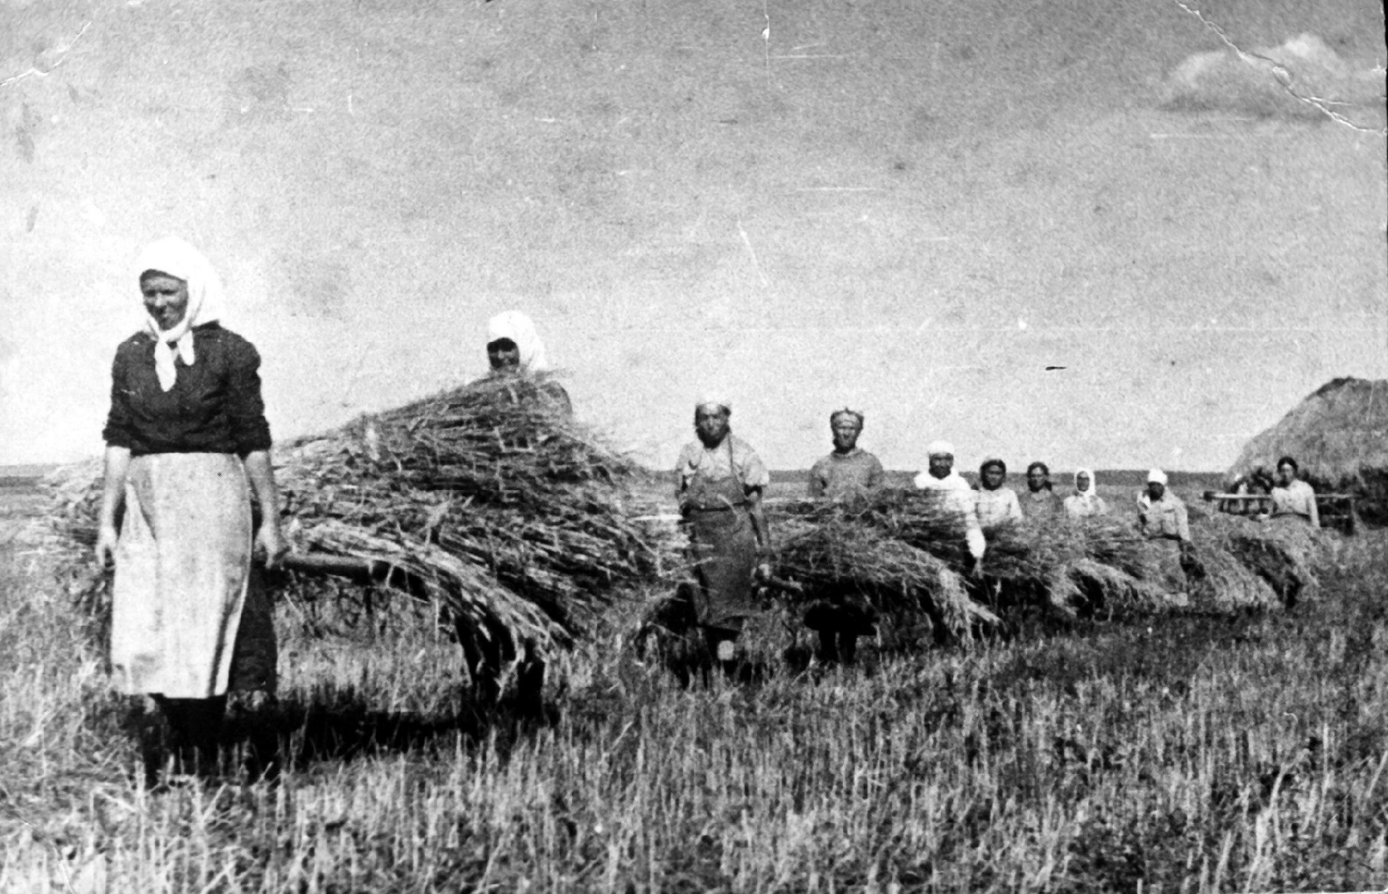
Data on Tambov Region livestock, 1938
World War II harvesting, 1944

Slide 25
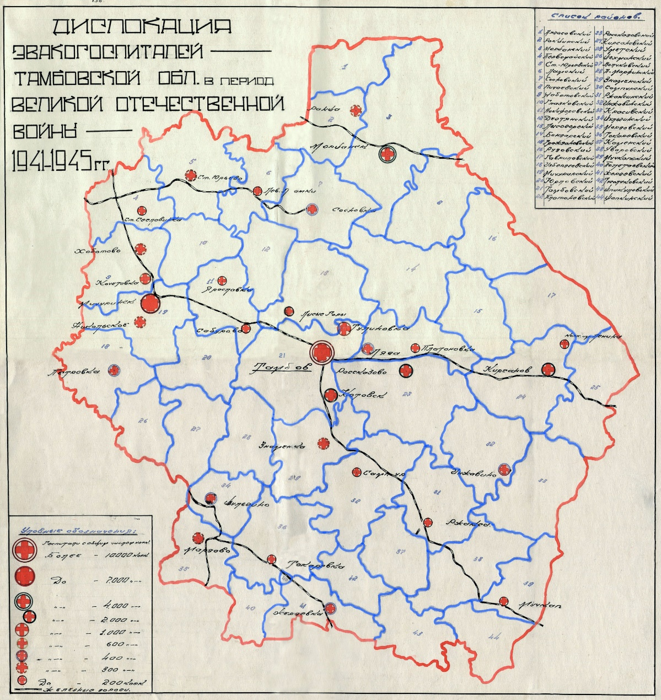
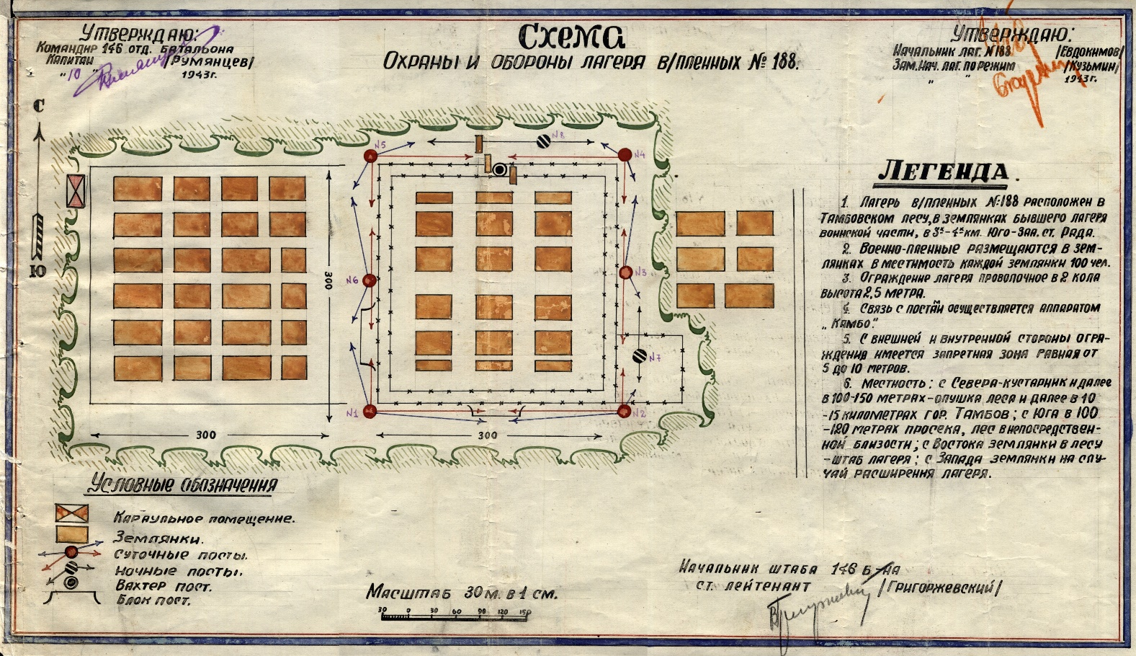
Military hospitals deployment,
1941-1945
POW camp N 188 (Rada), 1943

Slide 26
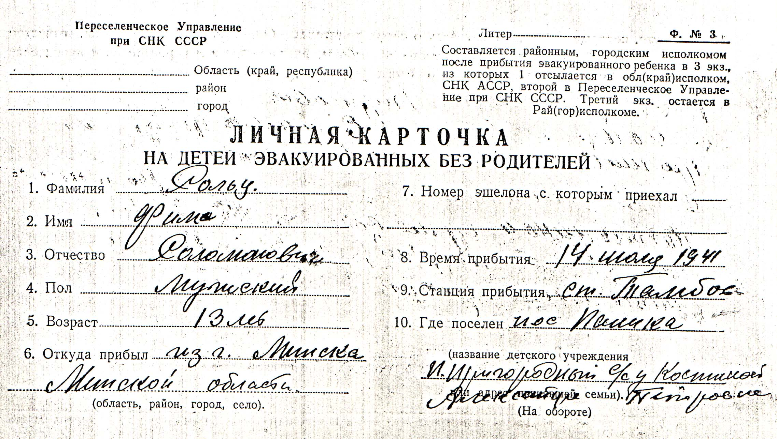
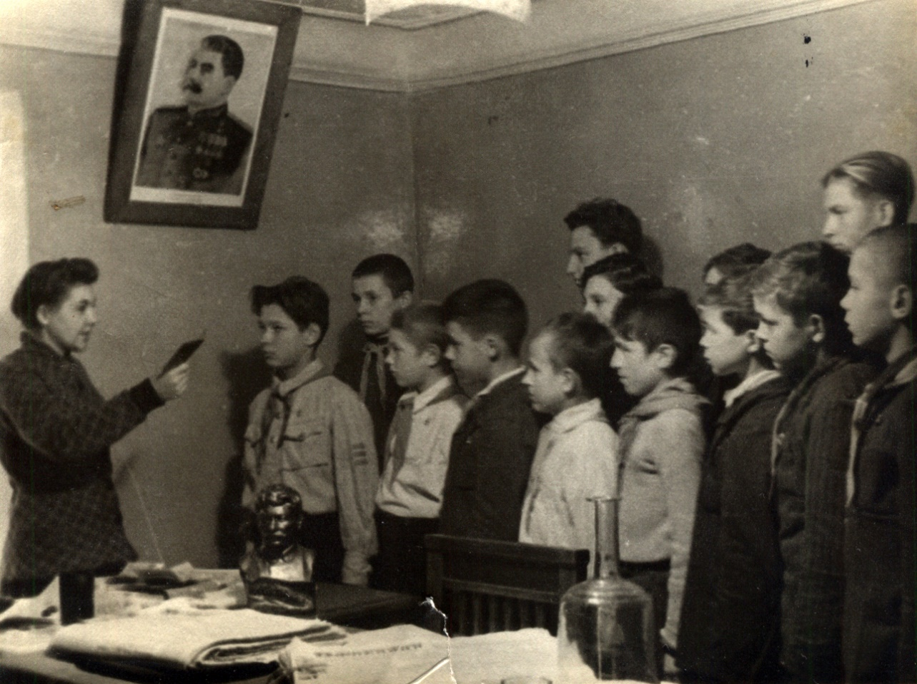
Personal card of a Jewish boy evacuated from Minsk to Tambov, July 14, 1941
Enrolment to the Komsomol in a rural subregion, 1944

Slide 27
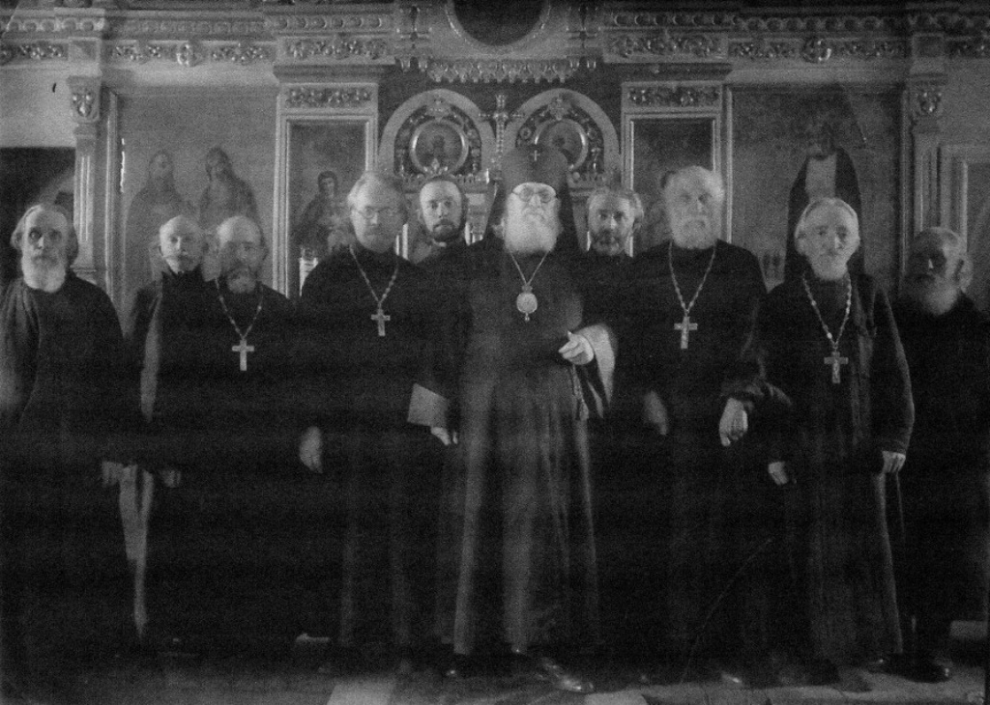
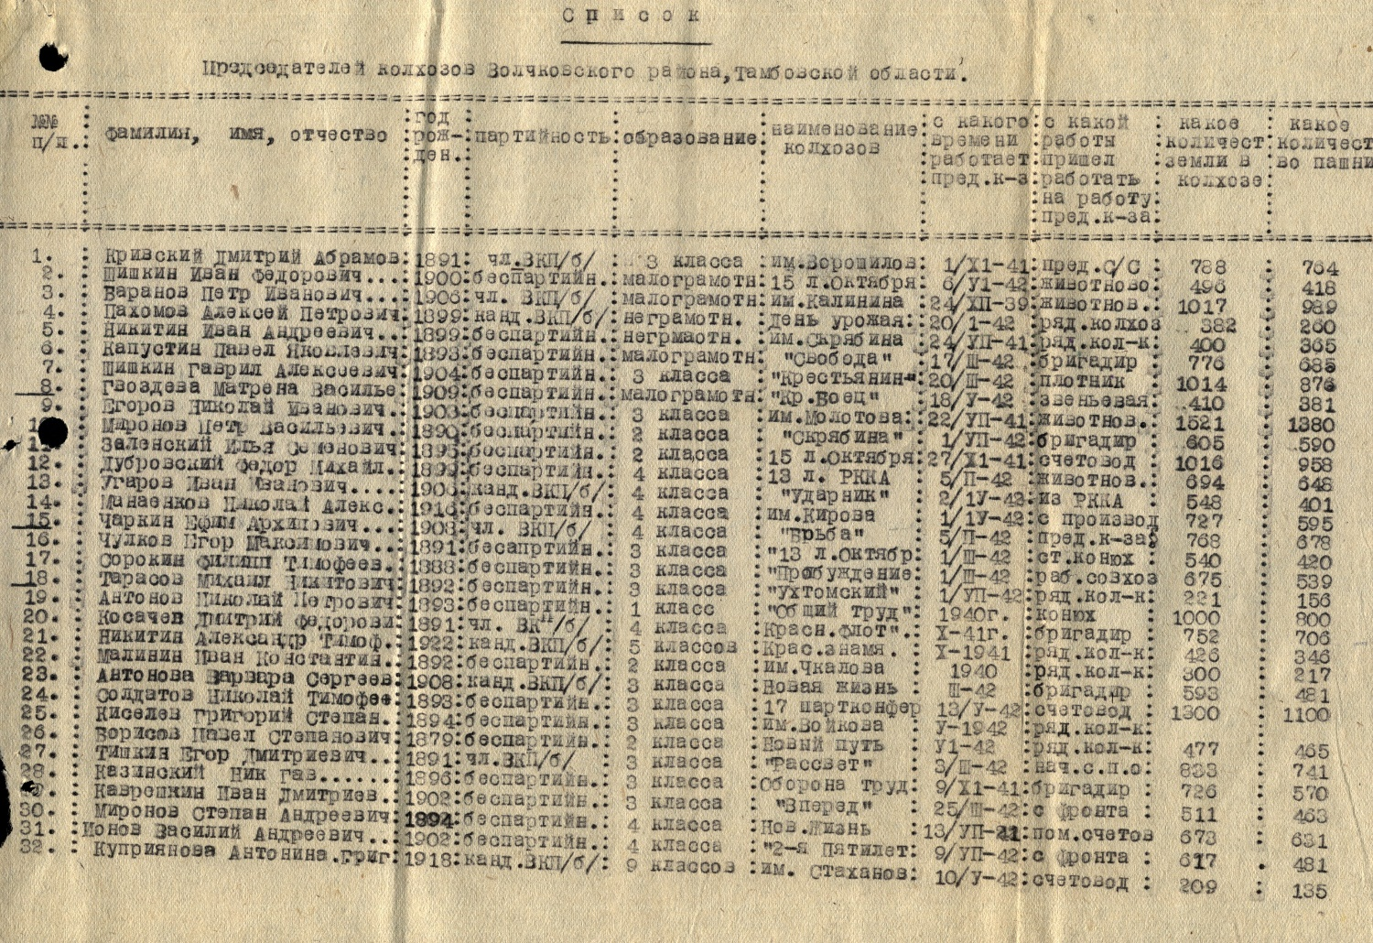
A list of collective state farm (kolkhoz) chairmen, 1942
A great surgeon and the Archbishop Lukas (V.F. Voino-Yasenetski) and Tambov clergy, 1944

Slide 28
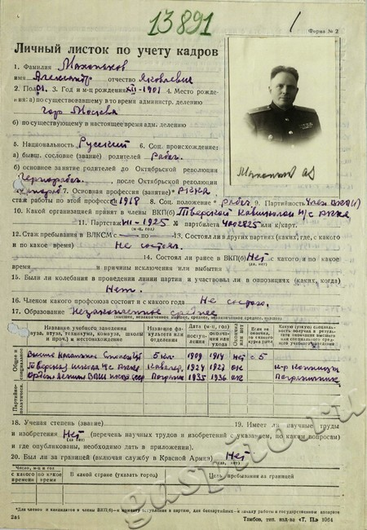
An interrogation of Hungarian chaplain who tortured the Red Army scout Tamara Derunets (1920 – 1942), 1947 (these files were transmitted from the Federal Security Services departmental archives)
Personal card of a head of Tambov Regional Department of Internal Affairs Major-General
A. Makhankov, 1950

Slide 29
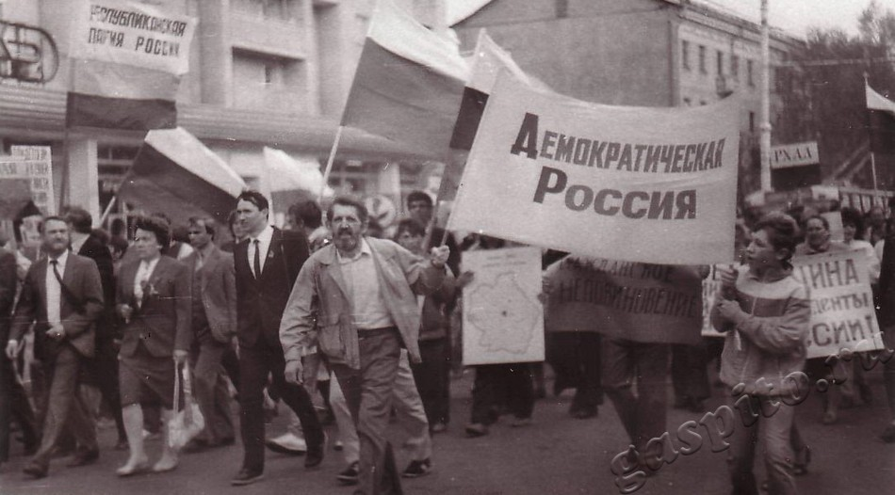
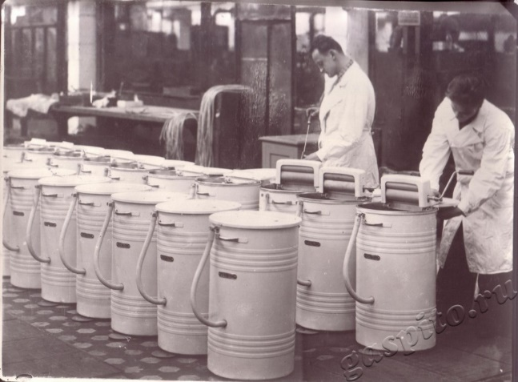
Washing machine production, Tambov, 1962
The “Democratic Russia” at the march,
Tambov, 1989

Slide 30
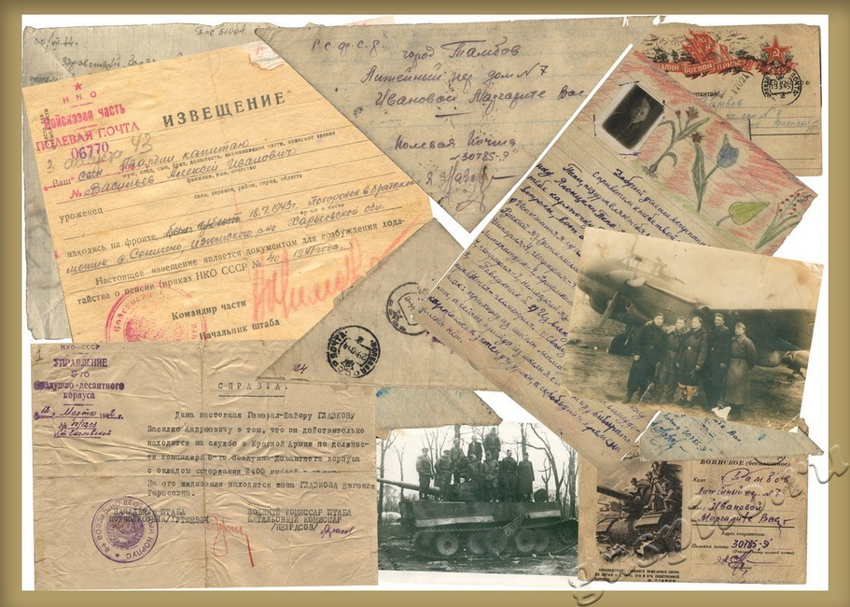
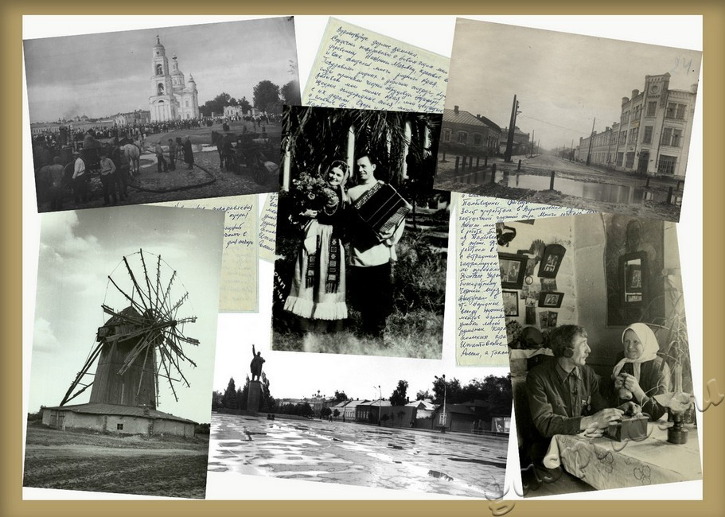
WW2 letters and photos collection
The 20th c. everyday life in photos

Slide 31
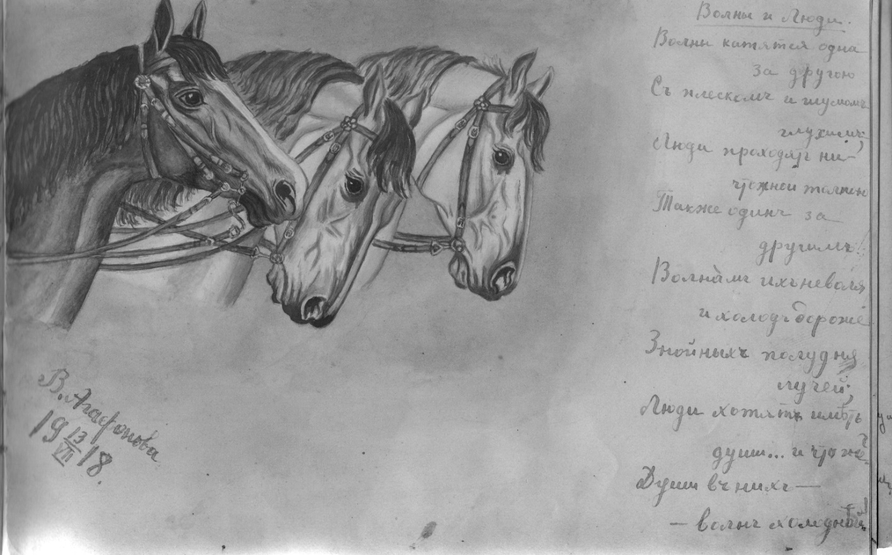
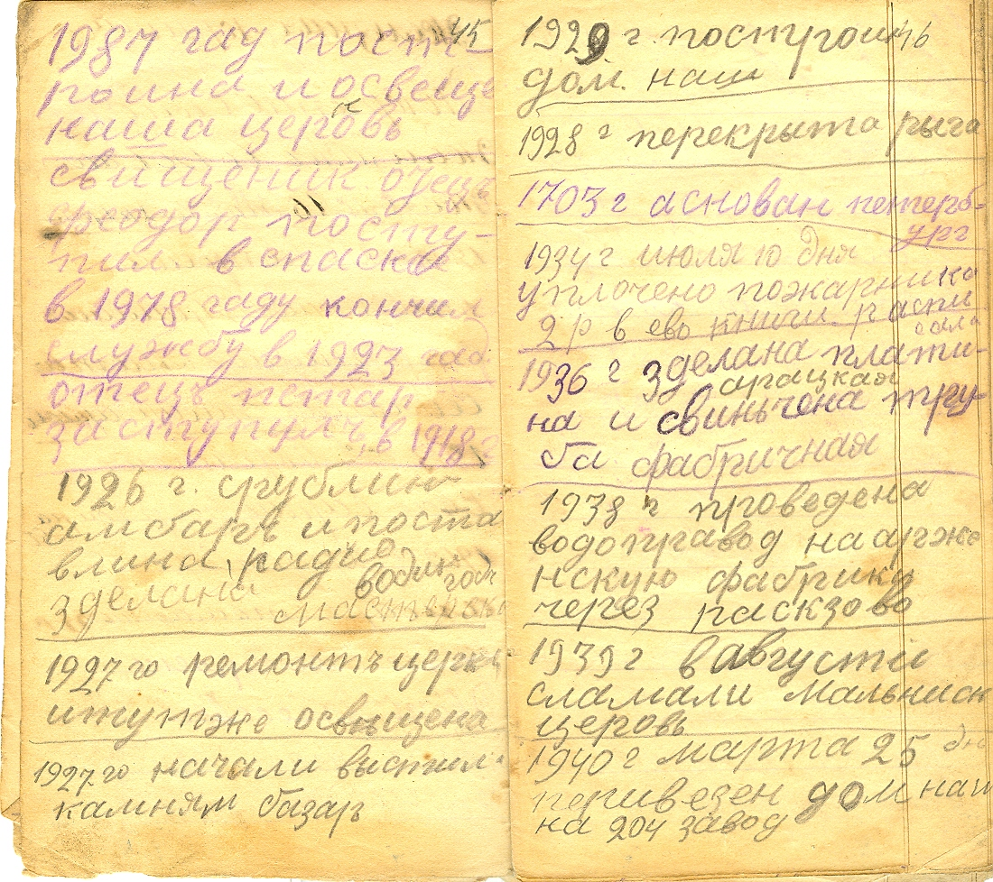
Pages from a peasant’s notebook,
1910-1935 (V. Litovski collection)
A page from Olga Kharina’s scrapbook, 1915-1918 (V. Dyachkov’s collection)

Slide 32
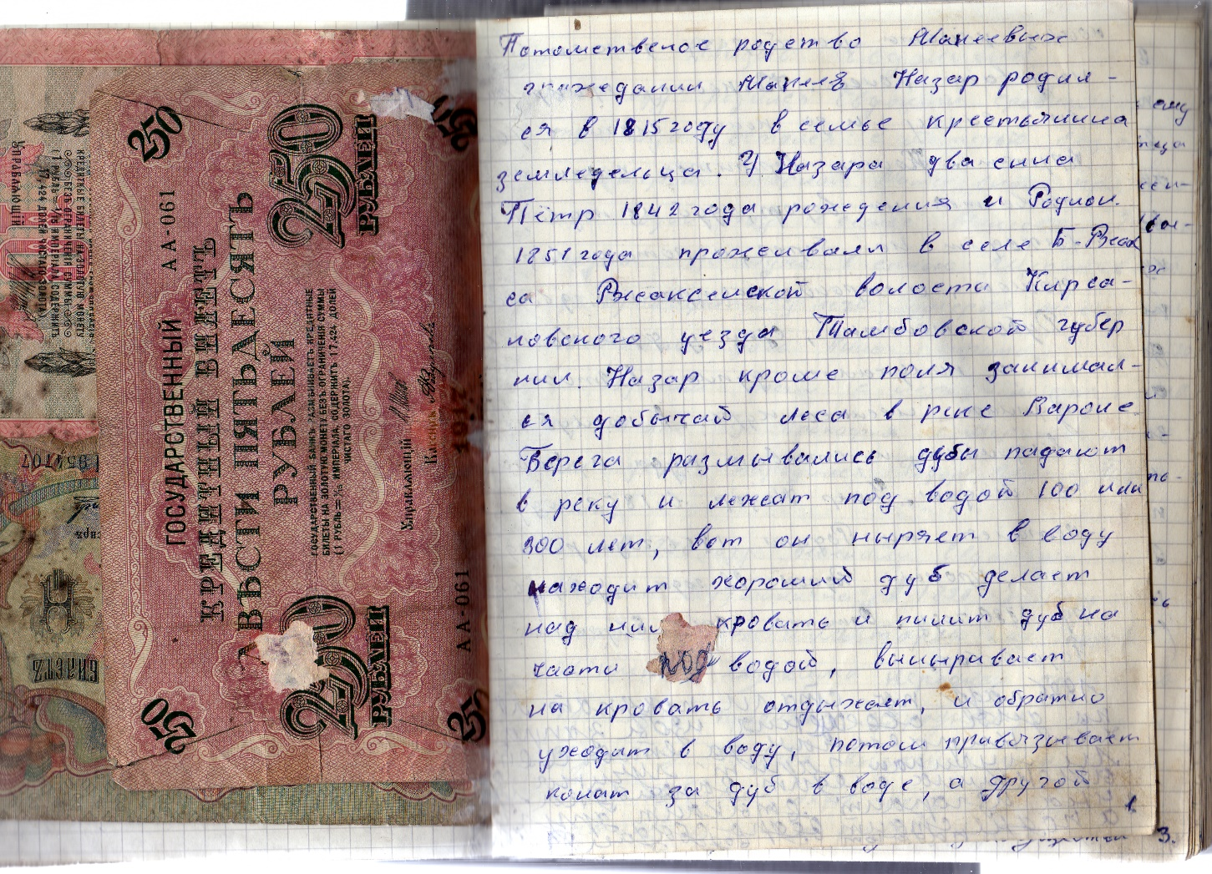
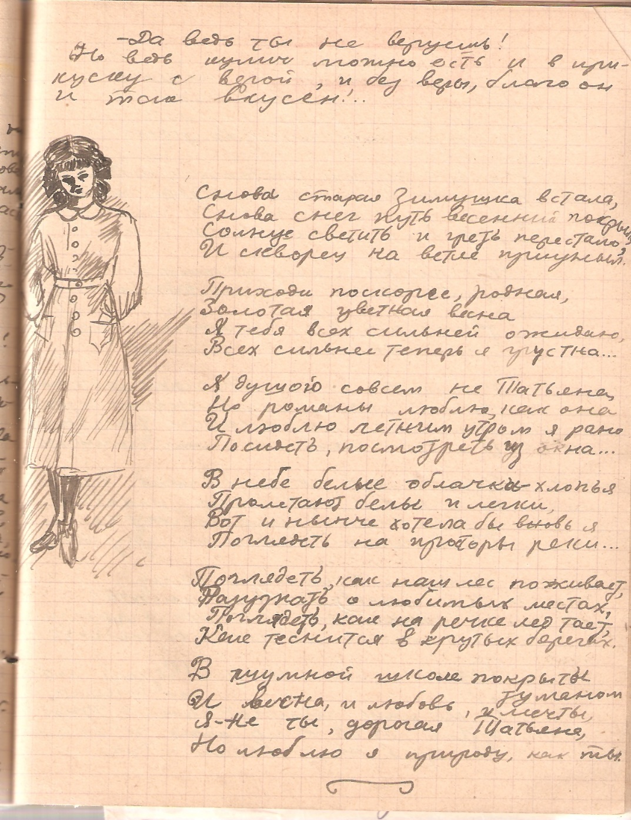
A page from Nina Peregud’s diary, 1940-1944 (V. Dyachkov’s collection)
A page from Ivan Makeev’s memoirs on 1914-1930 written in mid-1960s
(V. Dyachkov’s collection)

Slide 33
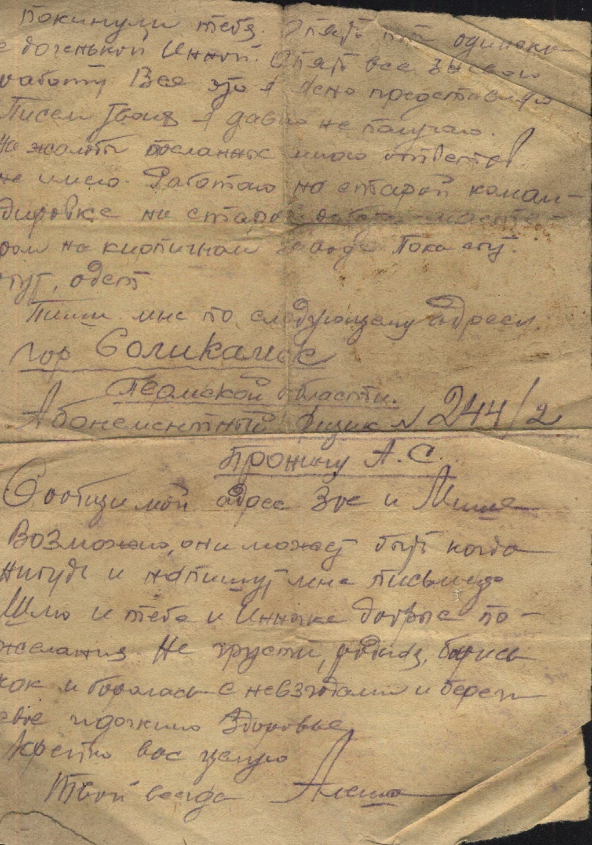
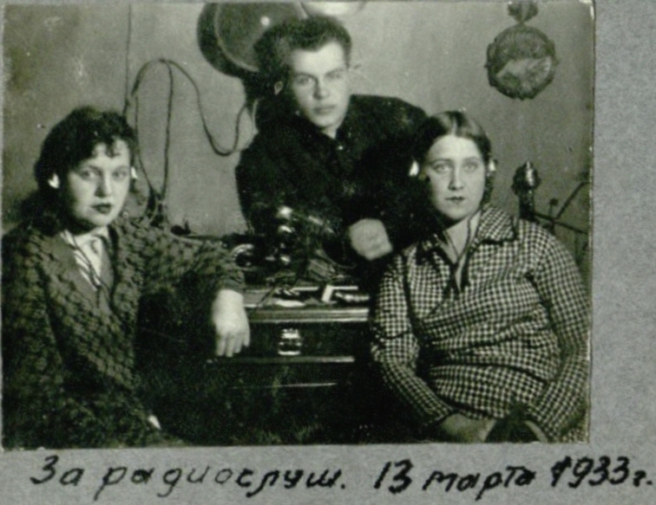
A letter from prison,1939 (A. Allenov’s collection)
Listening the radio, 1933 (V. Orlova’s collection)

Slide 34
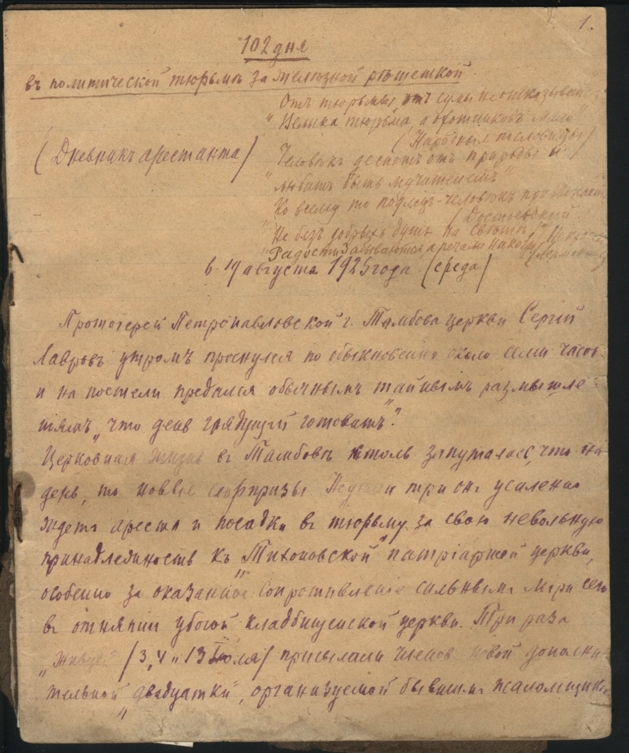

A page from a priest’ s diary written in jail, 1925 (TRegLHM)
A page from Vladimir Khersonski’s diary, 1940-1943 (TStMPI)

Slide 35


A page from Nikolay Nikiforov’s diary, 1945-1946 (V. Ermakov’s collection)
The stuff of a Soviet field camp for the Nazi POWs, Czechoslovakia, June, 1945 (TSU student’s collection)

Slide 36


Welcome to Tambov archives!

