Slide 1

Peter Ruggenthaler
Graz, Austria www.bik.ac.at
“The Russian State Archives for Contemporary History” (RGANI) https://ргани.рф

Slide 2



Red Army in Austria 1945-1955
Stefan Karner – Barbara Stelzl-Marx, ed., The Red Army in Austria. Harvard Cold War Studies Book Series. (Lexington, Lanham et al., 2020)

Slide 3



Slide 4


Prague Spring 1968

Slide 5


Kennedy – Khrushchev Summit
1961 in Vienna

Slide 6

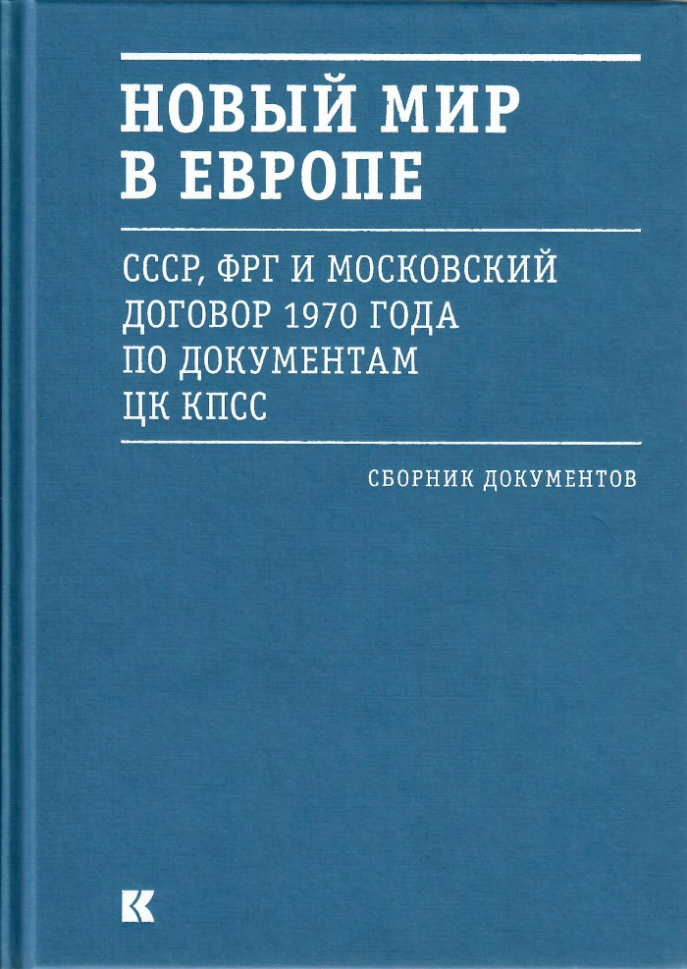
www.ostpolitik.de

Slide 7

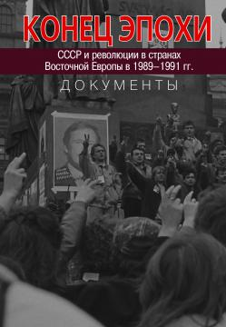

RGANI documents on 1989/90

