Slide 1
Doing Research at the State Archive of the Russian Federation (GARF) and the Gorbachev Foundation
Svetlana Savranskaya, Ph. D.
The National Security Archive

Slide 2
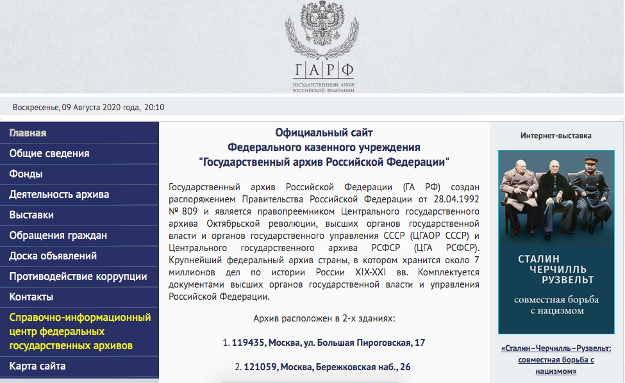
GARF is the largest archival repository in Russia open to Russian and international Researchers. To obtain the researcher pass and request materials, send a letter with your information to garf@statearchive.ru three weeks in advance of your visit. Main site of the archive: www.statearchive.ru Telephone: +7 (495) 580-88-61

Slide 3
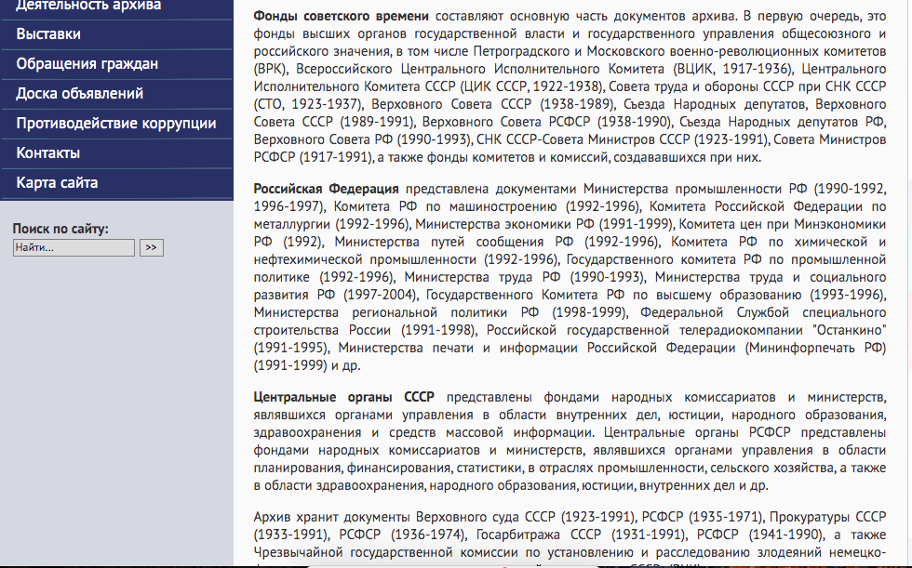
GARF collections contain numerous fonds of documents of Soviet legislative, state, and judicial organs, as well as documents from Russian state institutions after the dissolution of the USSR. Fond 10026—Supreme Soviet of the Russian Federation 1990-1993 Fond 10100—State Duma of the Russian Federation 1994-

Slide 4
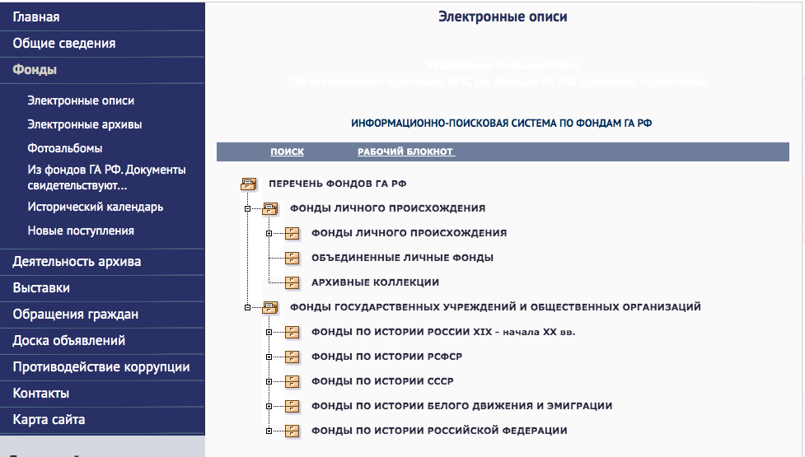
GARF has an extensive and user-friendly system of electronic finding aids that allows a researcher to prepare for his or her visit remotely. Take time to familiarize yourself with the collections and the search engine.

Slide 5
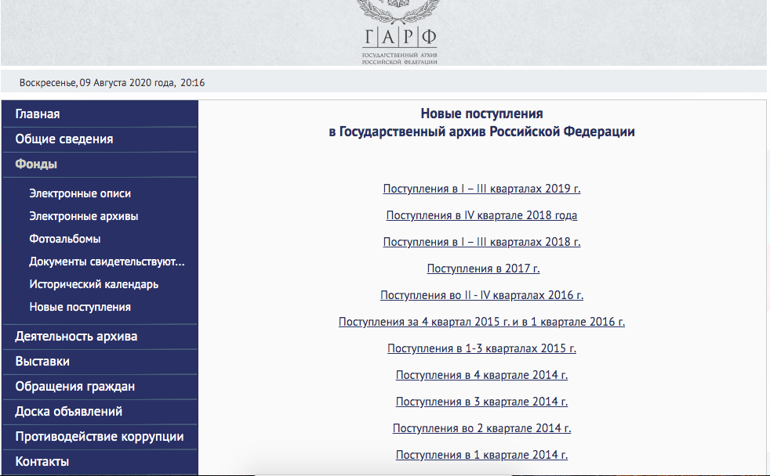
One can see which new collections and folders were added to GARF since the last visit. Also, if you used an electronic request system, your previous requests and the list of the documents you have already seen, will be saved in your “notebook”

Slide 6
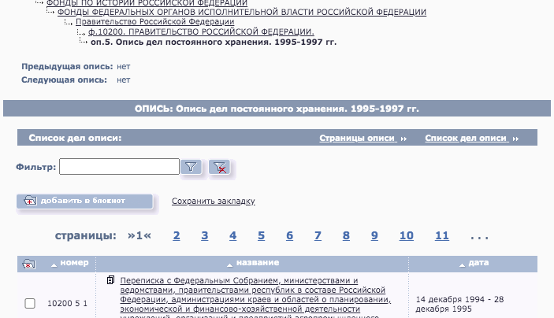
GARF search function allows a researcher to search for terms, names, dates down to individual file names. You can also scroll down a particular list of files in a folder to get a better understanding of files for a particular government agency, such as a Duma committee. You can save results of your search and selected files in your notebook for future research

Slide 7
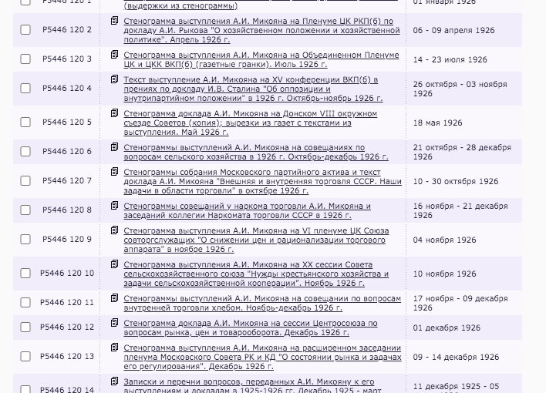
Here is an example of my search for Deputy Prime Minister Anastas Mikoyan Materials

Slide 8
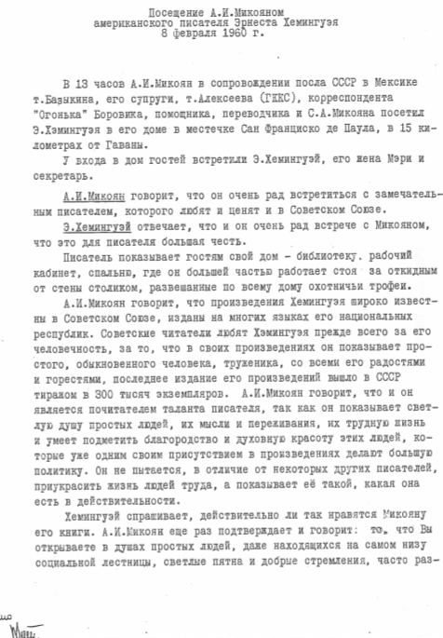
After your search in the electronic system, you can send a request by email and see a document like this: Conversation between Anastas Mikoyan and Ernest Hemingway

Slide 9
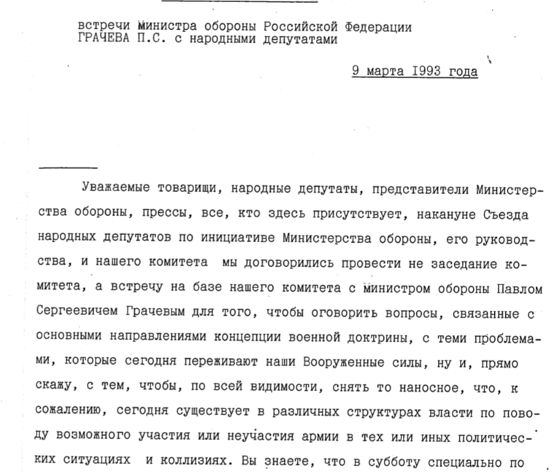
Here is an example of amazing material one can find in fond 10026: Transcript of Defense Minister Pavel Grachev meeting with Duma deputies on March 9, 1993

Slide 10
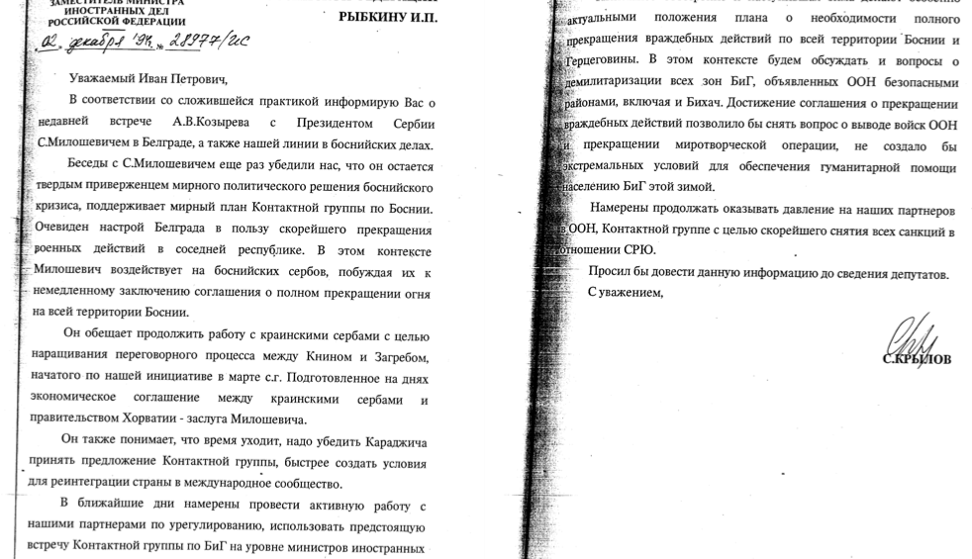
In fond 10100 one can find numerous memos between Speaker of the Duma and various government agencies, as well as correspondence between the Speaker and the President of Russia Boris Yeltsin. Here is a report to Speaker of the Duma Ivan Rybkin from the MFA

Slide 11
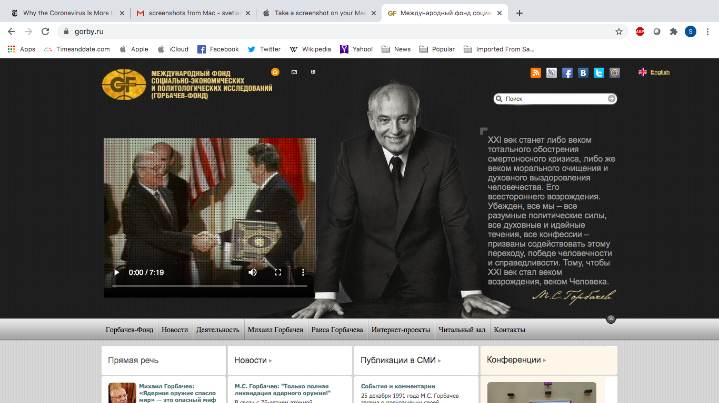
The Gorbachev Foundation archive is a unique private repository of documents on all aspects of Soviet reforms in 1985-1991. It contains collections of documents of Gorbachev’s meetings with foreign leaders, notes from Politburo sessions and large collections of memoranda and reports.

Slide 12
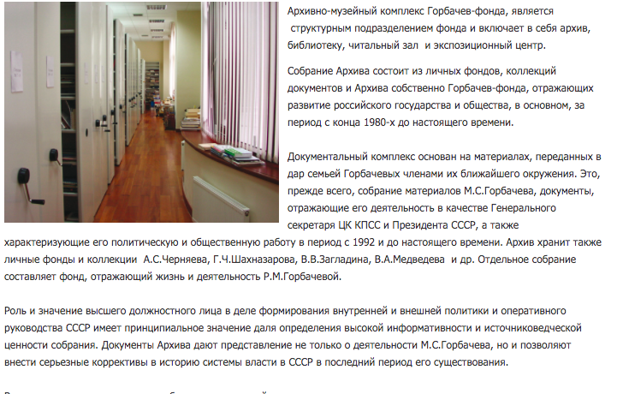
Gorbachev Foundation Archive does not have a system of a remote electronic assess. To visit the reading room, one needs to send a letter and specific research request a month in advance. The collections are fully digitized and equipped with digital finding aids and a search engine only accessible on site. Telephone: +7 (495) 945-77-51 email: gorby@gorby.ru, alit@gorby.ru

Slide 13
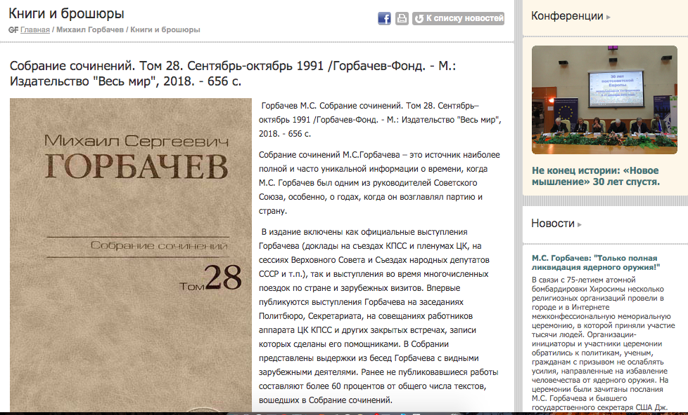
Gorbachev Foundation is an active research institute and think tank. It holds regular seminars and workshops on political and social issues. Announcements and reports can be found on its website. The Foundation also has an active publication program. Most of Gorbachev documents could be found it is publications, such as Sobranie Sochinenii

Slide 14
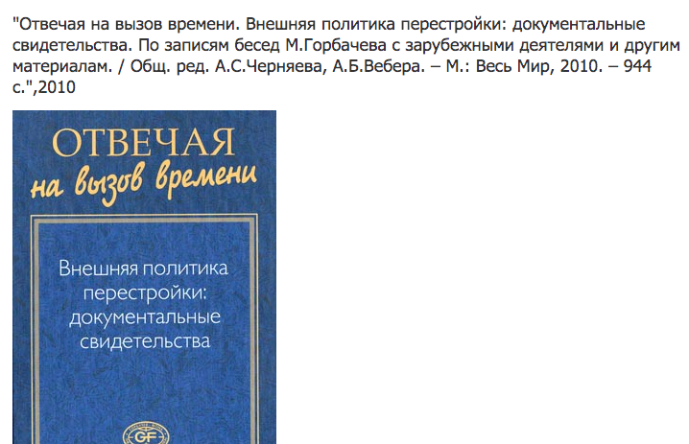
For researchers interested in Gorbachev’s foreign policy and the end of the Cold War, many of the memoranda of conversation (memcons) of the meetings between Gorbachev and foreign leaders can be found in this book

Slide 15
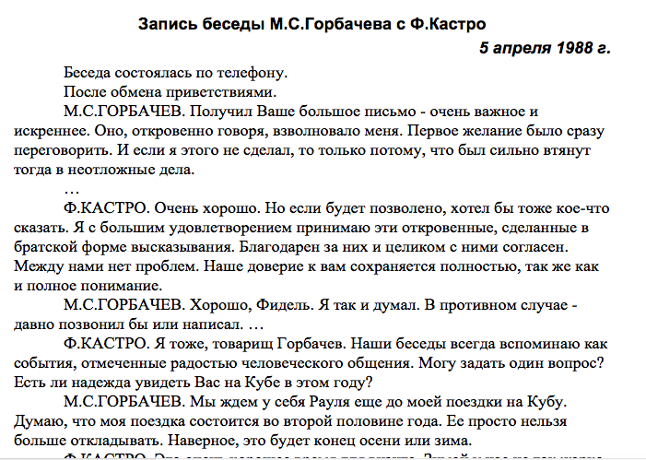
For example this record of telephone conversation between Mikhail Gorbachev and Fidel Castro on April 5, 1988

Slide 16
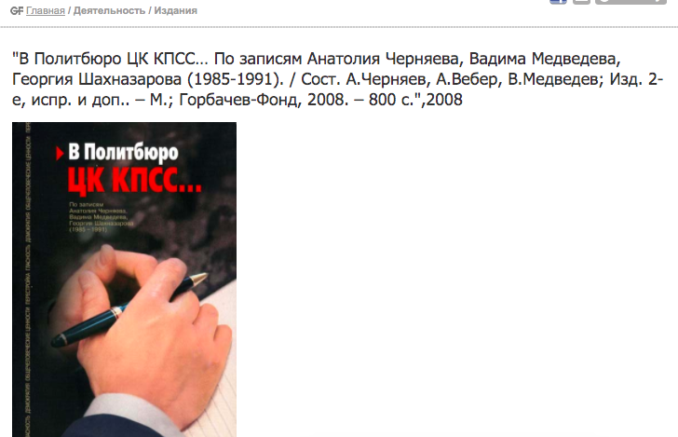
While official records of the Politburo still remain classified in the Presidential Archive of the Russian Federation, the Gorbachev Foundation published notes of Gorbachev’s advisers from the Politburo sessions that are invaluable for researchers

