Slide 1
Archives and Soviet Studies in Georgia
Giorgi Kldiashvili
Executive Director of the Institute for Development of Freedom of Information (IDFI)
Photo: National Archives of Georgia

Slide 2
Main Archival Institutions in Georgia
The National Archives of Georgia
Chronological frame: 9th Century – Present
Number and Type of documents: 10,295 archival fonds (approx. 75km.)
Legislative framework: On the National Archival Fund and the National Archives (LHG, 51, 31/12/2006)
The Archive of the Ministry of Internal Affairs (MIA) of Georgia
Chronological frame: 1921-1991
Number and Type of documents: 8,300 archival fonds (approx. 5km.)
Legislative framework: On the National Archival Fund and the National Archives (LHG, 51, 31/12/2006); Special Order of the Minister of Internal Affairs

Slide 3
Archival Institutions in Georgia
Georgian National Centre of Manuscripts (9th Century – Present) Repository of ancient manuscripts, historical documents and the private archives of prominent public figures
Departmental archives: Archive of the Ministry of Defense; Archive of the Department of Common Courts; Archive of the Ministry of Foreign Affairs (1991-present) Documents created during the independence period (after 1991) by various state agencies
Archival Division of the Autonomous Republic of Adjara (1930’s-present) Documents concerning the activities of the organizations, institutions and prominent figures on the territory of the Autonomous Republic of Adjara
The National Parliament Library of Georgia (17th Century – Present)
In addition to the rich book collection and periodicals, the library holds a small number of archival documents. The library has a significant photo collection
Private Archives (1991-present) Private archives are not developed in Georgia. Very few of them keep documents from private organizations (e.g. commercial banks). Most of the private organizations have their own archives

Slide 4
www.ava.ge - The Abkhazian Virtual Archives (AVA) is a web-based archive that includes the information about Abkhazia in the form of photos, videos, books, newspapers, manuscripts, maps and family archival materials.
The project was implemented with the support of the President of Georgia and is a modest attempt to replace the archives that were destroyed and burnt during the war in Abkhazia (1992-1993). All documents are in a free access. Finding aid is available in Georgian, English and Abkhazian languages.

Slide 5
The National Archives of Georgia
Central Historical Archive: documents from the 9th century to 1921
Historical documents created during the feudal Georgian state (9th cent. - 1800), under the Russian Empire (1801-1917) and the First Democratic Republic of Georgia (1918-1921)
Central Archive of Contemporary History: 1921 – Present Documents created during the Soviet Socialist Republic of Georgia (1921-1991) and the independence period of Georgia (1991-Present)
Central Archive of Audio-Visual Documents
More than 500,000 photos, about 20,000 audio records and nearly 35,000 films
Kutaisi Central Archive: 19th century – present Documents concerning the activities of the organizations, institutions and prominent figures on the territory of Western Georgia

Slide 6
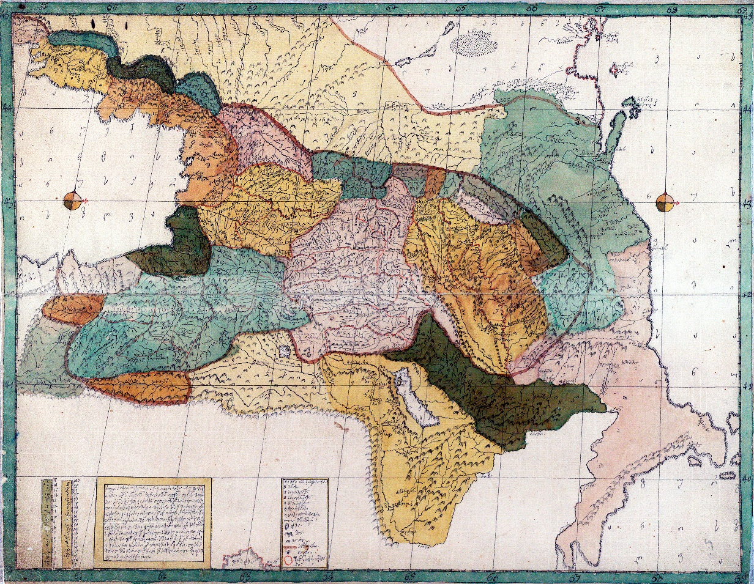
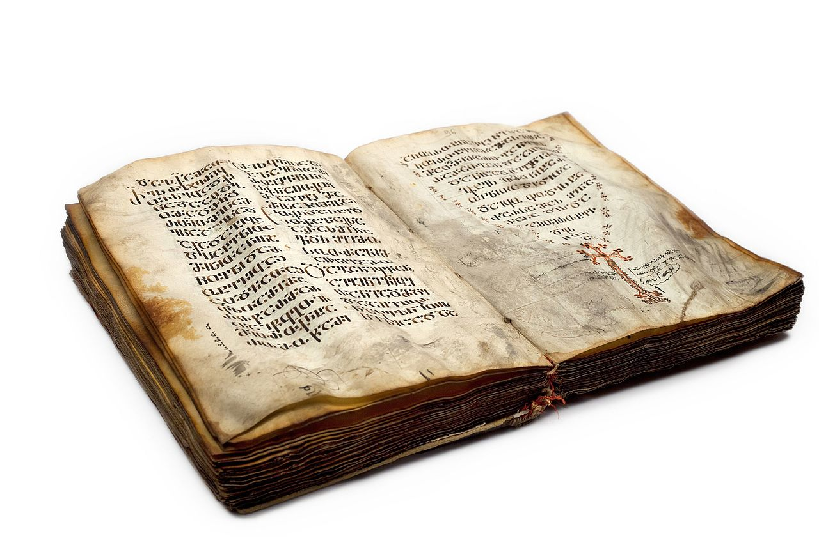
Documents of the National Archives of Georgia are Included in the UNESCO World Heritage List and are Protected Internationally
Vakhushti Bagrationi's "Description of the Kingdom of Georgia" and "Geographical Atlas”, XVIII cent.
Eight Ancient Manuscripts (IX-XV centuries)

Slide 7
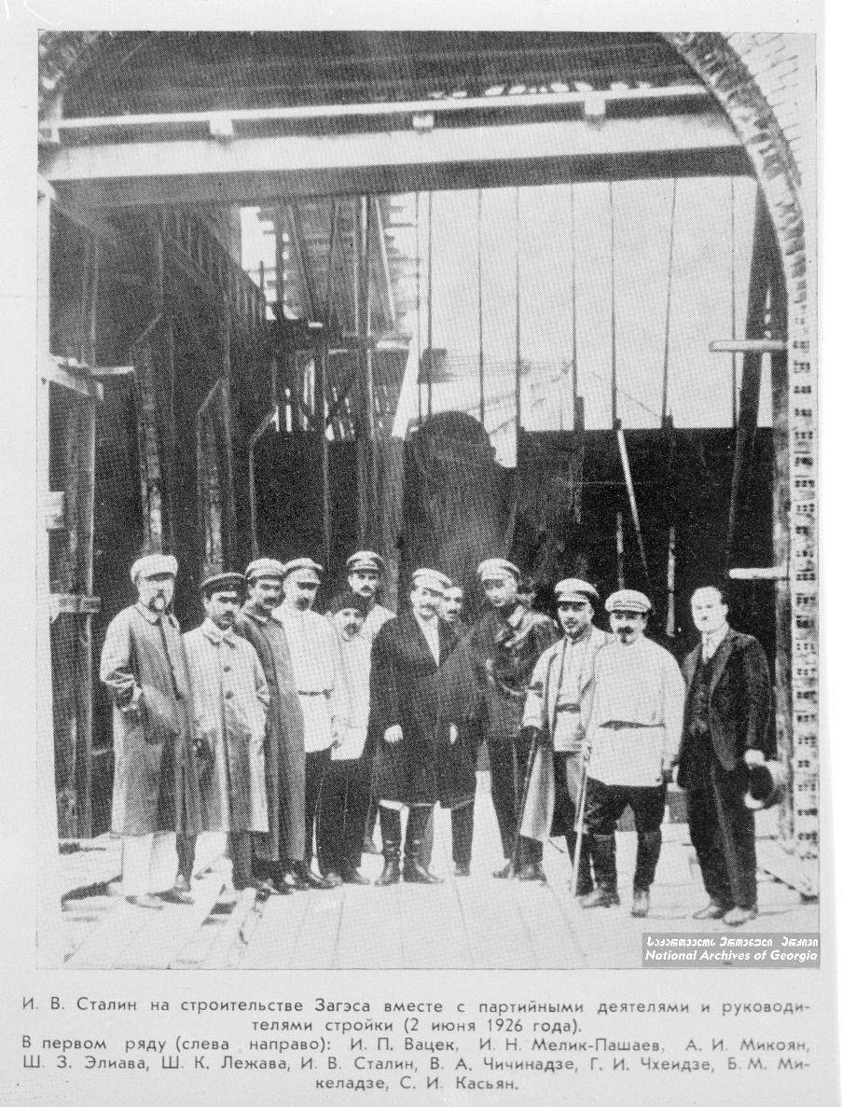
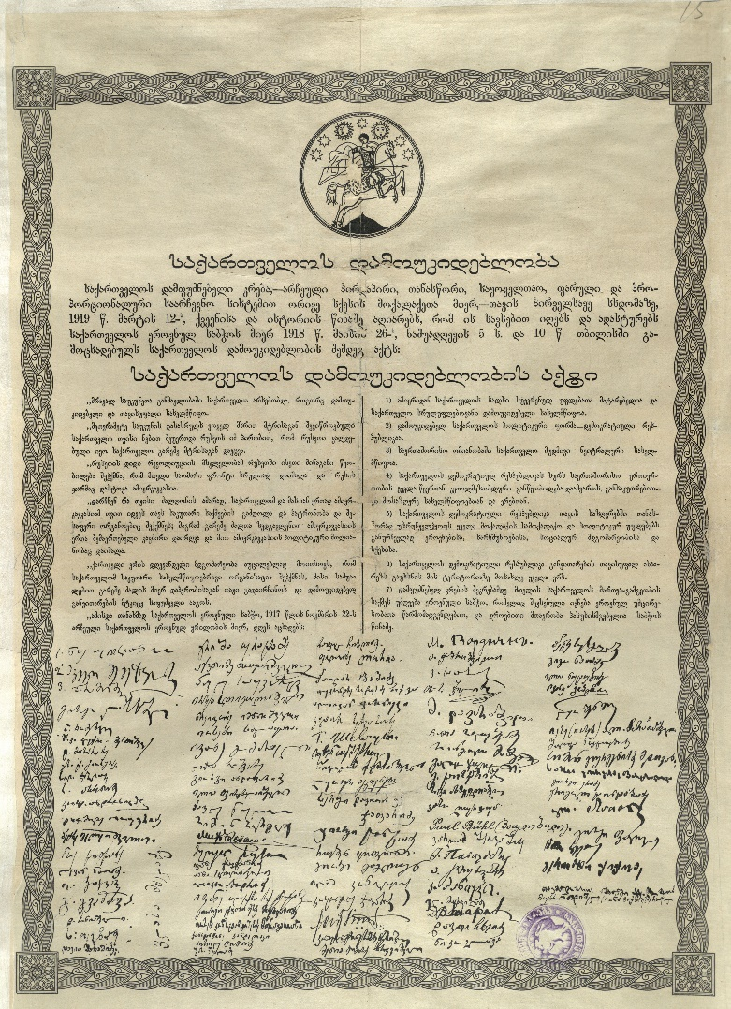
Act of Independence of Georgia, ratified by the Constituent Assembly, March 12, 1919
Stalin at the opening of the hydroelectric power plant near Tbilisi, 1926
Documents of the First Democratic Republic of Georgia (1918-1921) and the government in exile (1921-1980)
Archives of the Soviet Period (1921-1991)

Slide 8
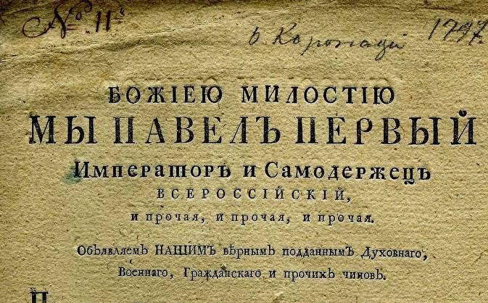
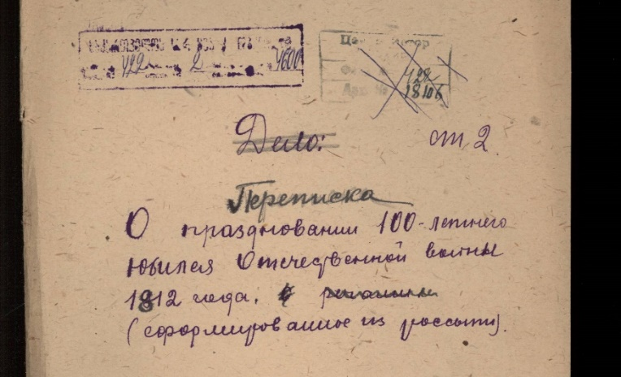
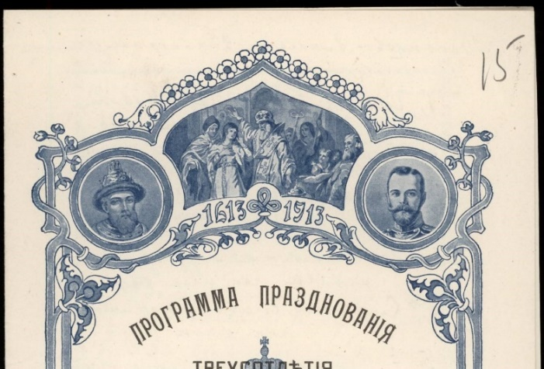
The Most Important Fonds Preserved in the Central Historical Archive of Georgia
Fond №1 - №12, Chancellery of the Caucasus Viceroyalty and other related fonds
The Caucasus Viceroyalty was the administrative and political authority of Imperial Russia in the Caucasus region. The first time Russian authority was established in the Caucasus after the Russian annexation of the Kingdom of Kartli-Kakheti (eastern Georgia) in 1801.
Eventually, the jurisdiction of the Russian Empire expanded to what is now Georgia, Armenia, Azerbaijan, and the North Caucasus, as well as the parts of Northeastern Turkey (today the provinces of Artvin, Ardahan, Kars, and Iğdır) and it was one of the most diverse and interesting regions.
These fonds are very important as long as they cover the establishment and strengthening of the Russian administration in the region. They also include the materials on the Caucasian wars. They are the first organized chancellery in the region in general and are important for the study of this whole region and epoch.

Slide 9
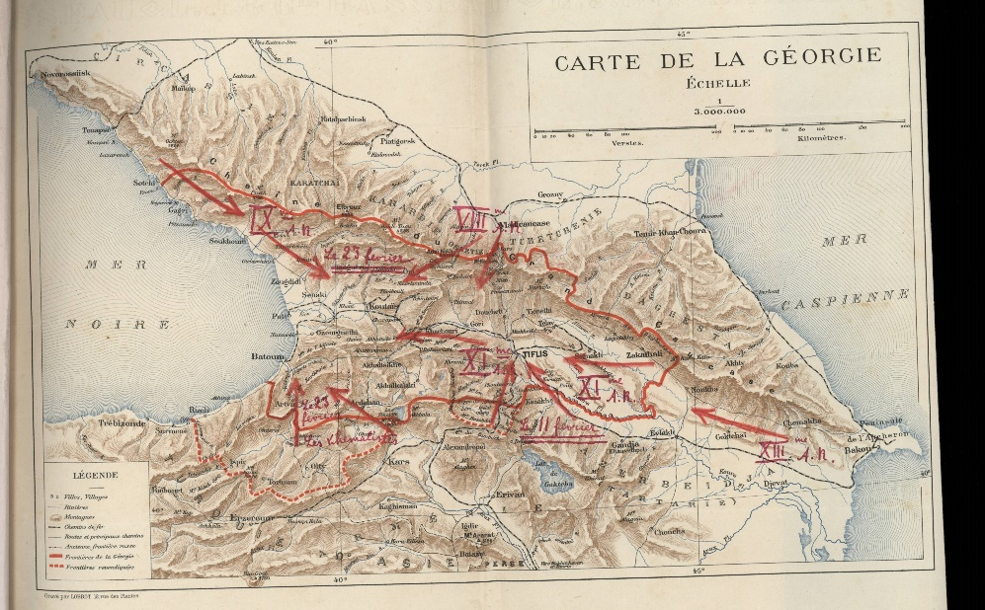
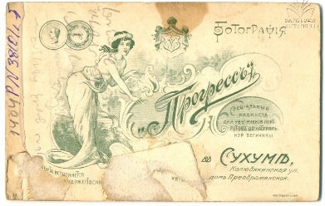
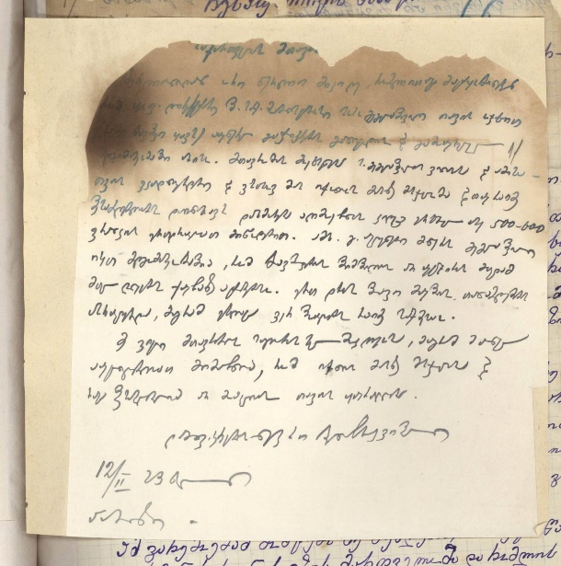
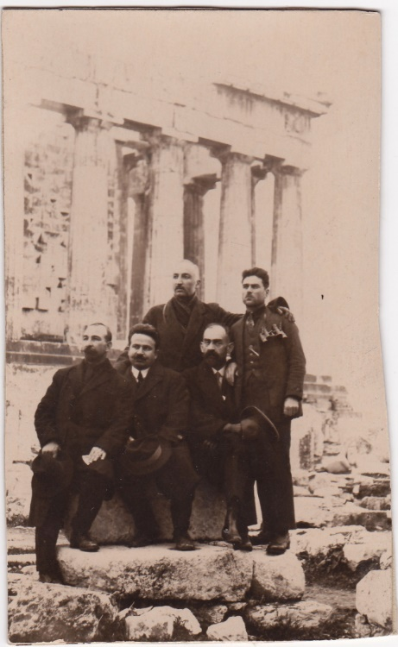
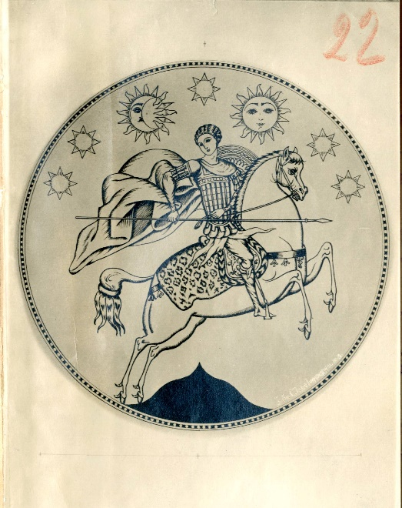
The Most Important Fonds Preserved in the Central Historical Archive of Georgia
Fond №1833 - №1961, fonds of the First Democratic Republic of Georgia (1918-1921)
Fonds concerning the First Republic of Georgia, including important materials of the Ministry of Foreign Affairs, the Ministry of Defense and the National Guard, Parliament and other institutions. Also, personal fonds of the political leaders of the republic - Noe Zhordania, Noe Ramishvili, Karlo Chkheidze and others.
The documents cover not only the three years of the existence of the republic, but also the struggle of the government in exile for restoring the independence of Georgia.
The fonds were taken by the government in exile in 1921 and were returned to Georgia after the restoration of independence, in the late 1990’s.

Slide 10
The Most Important Fonds Preserved in the Central Archive of Contemporary History of Georgia
Documents concerning the Soviet Socialist Republic of Georgia (1921-1991) excluding the archives of some law enforcement agencies (Ministry of Internal Affairs, Committee of State Security (former KGB))
Documents concerning the history of modern Georgia, materials about the work of institutions, local municipalities, administrations (excluding Departmental archives: Archive of the Ministry of Defense; Archive of the Department of Common Courts; Archive of the Ministry of Foreign Affairs). The archive is being constantly updated and has a great potential.

Slide 11
The Most Important Fonds Preserved in the Central Archive of Contemporary History of Georgia
Materials concerning the sovietization of Georgia - documents of the various revolutionary committees (RevCom) established in 1921 - the documents clearly show the tendencies used by the Soviet Empire to forcibly integrate the conquered states and form the new units of governance.
Documents about the national uprising of the Georgian people (the August 1924 uprising) (except for criminal cases) - various memories, documentary materials, letters, cases of the prosecutor's office, etc.
Demographic materials (birth, death, marriages) of 1921-1945 (Civil Registry Agency is obliged to transfer the above-mentioned documents to the archives after 75 years).
Georgian Patriarchate fond - one of the most important fonds as long as the Patriarchate was directly linked to the state security agencies of the Soviet Union and religion was under surveillance.
Georgian Writers' Union Foundation - the fond includes the activities of this Soviet agency, among which the minutes of the meetings of the 1930s are especially important, revealing how some writers tried to discredit their colleagues in order to escape repressions.
Special subdivision of the Literature and Art - preserving fonds concerning the literature and art agencies during the Soviet period. The subdivision was a separate archive, but has been merged with the Central Archive of Contemporary History in the 2000s.

Slide 12
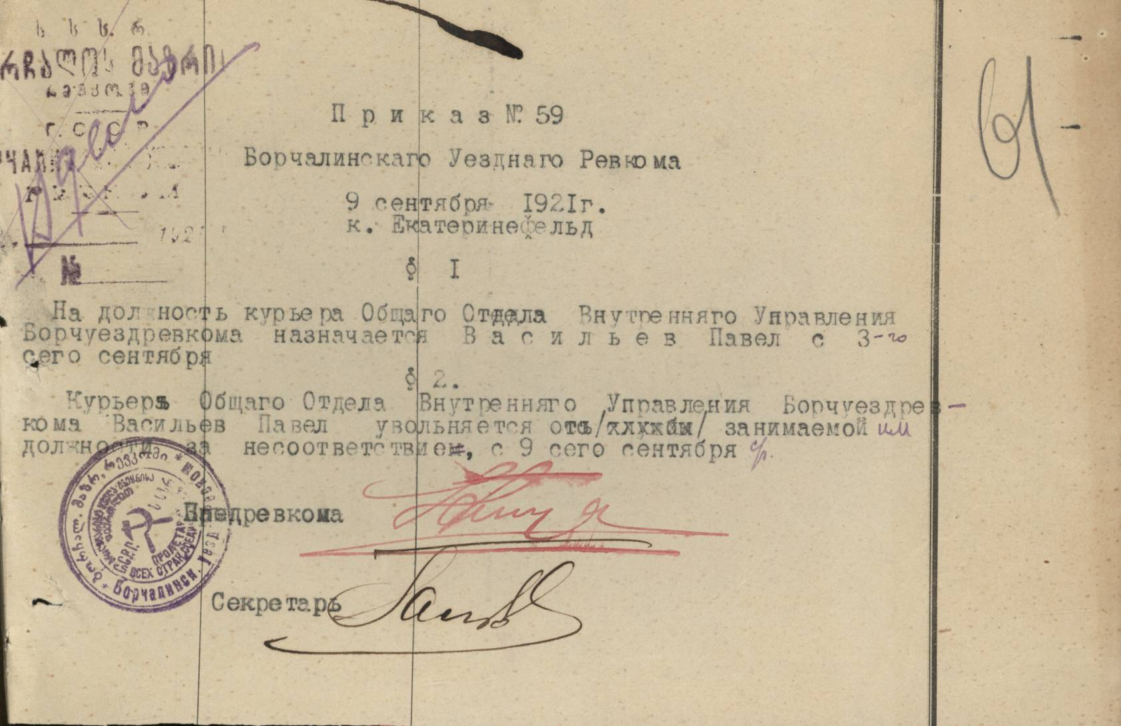
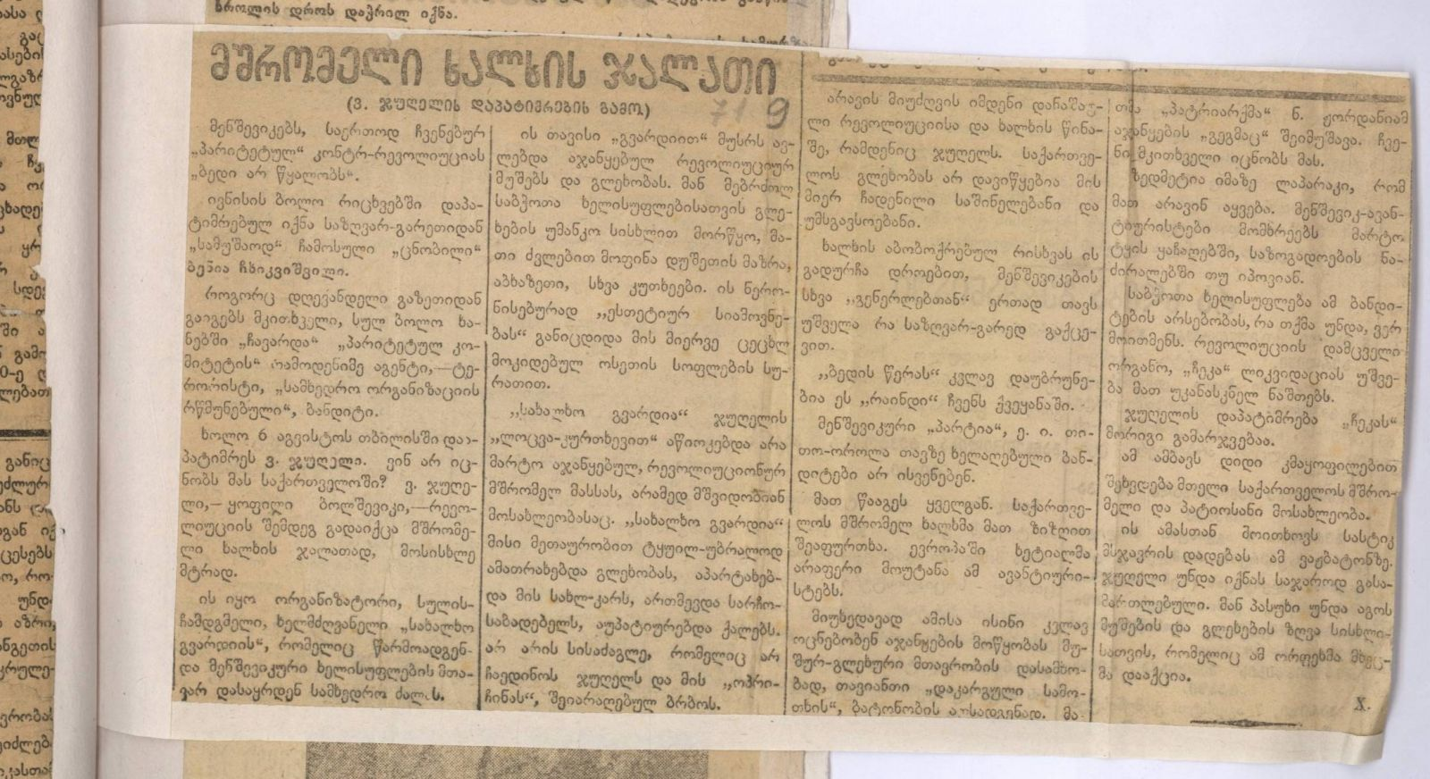
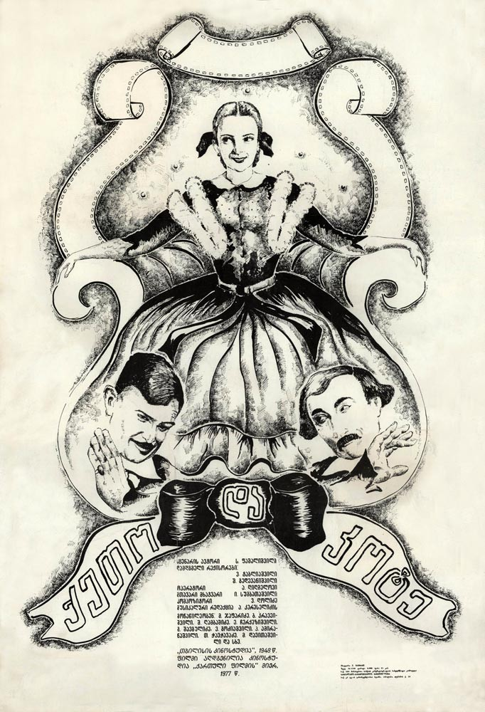
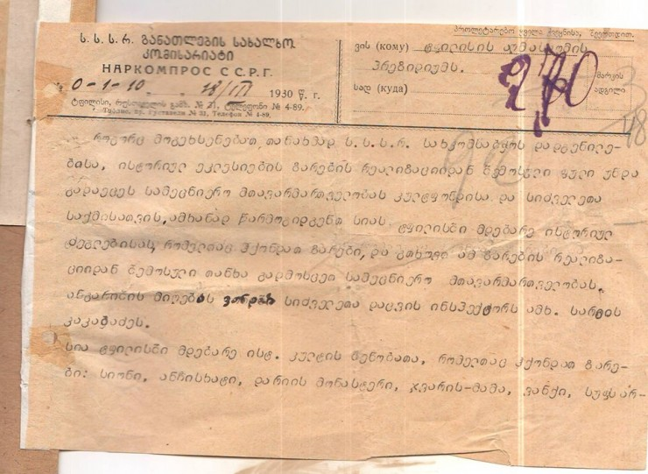
A newspaper report on the suppression of the 1924 uprising and the arrest of its leader
So-called Shulaveri RevCom document, 1921
The poster of Soviet Georgian Cinema – “Keto and Kote”, 1948
Notice about melting down of the church bells and using them as metal, 1930
Birth record from 1927

Slide 13
The Archive of the Ministry of Internal Affairs (MIA) of Georgia
Security archive (Archive of the State Security Committee of the Georgian SSR)* Documents of the Georgian repressive state institutions Cheka/GPU/OGPU/NKVD/MVD created between 1921 and 1990
Party archive (The Archive of the Central Committee of the Communist Party of the Georgian SSR) Archival fonds and materials on the history of the Communist Party of GSSR as well as the history of the Young Communist League (Komsomol) of GSSR
*The former KGB’s central building caught fire during the “Tbilisi War” of 1991-1992. As a result, 210,000 archival files were destroyed - 80% of the entire collection. Source: http://archive.mia.gov.ge

Slide 14
Most Important Collections Preserved in the MIA Archive (former KGB Archive) of Georgia
Fond №1, Normative Acts - Normative acts (decrees, orders and directives) passed by the Special Committee (Cheka), State Political Directorate (GPU), Joint State Political Directorate (OGPU), People’s Commissariat for Internal Affairs (NKVD) and Ministry of Internal Affairs (MVD).
Fond №6, Criminal Cases - Criminal cases of the Special Committee (Cheka), State Political Directorate (GPU), Joint State Political Directorate (OGPU), People’s Commissariat for Internal Affairs (NKVD), State Security Committee (KGB) and Ministry of Internal Affairs (MVD). These documents were created between 1919-1989. The Archive holds 20,000 criminal cases, most of which concern the persons tried under the Article on political crimes: Article 58-10 (anti-Soviet agitation/propaganda) and 58-11 (organizing anti-Soviet activities).
This fond contains exclusive materials about the 1924 Uprising. These materials (4,100 cases) are dispersed throughout the files created between 1925-1927. Fond №6 holds 4,180 criminal cases of the 1937-1938 Great Purge. Fond №6 also includes criminal cases from the Second World War and the following period (1939 - 1950). These cases were created on the basis of the Article 58-1 (treason), and those convicted were sentenced to 25 years in prison. Family members of the “traitors” were also tried. From the later decades, the cases include the 1970s dissident movement, Helsinki Group and the twenty-two volumes of the Hijackers Case (№8309) in the 1980s.

Slide 15
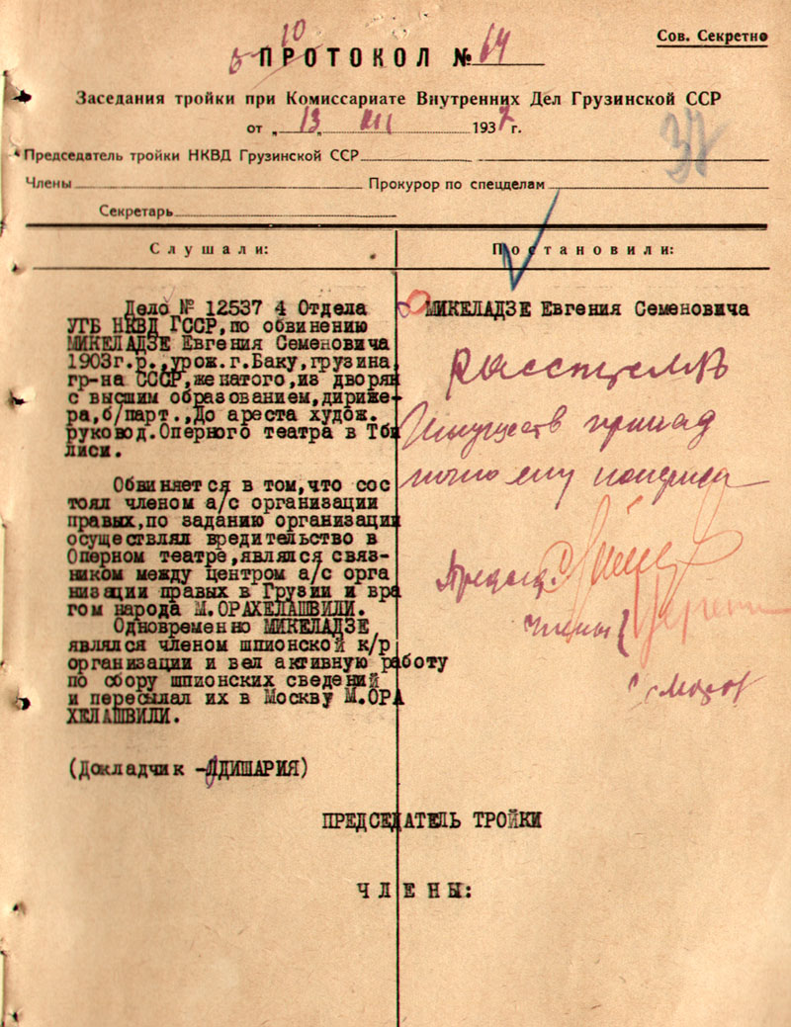
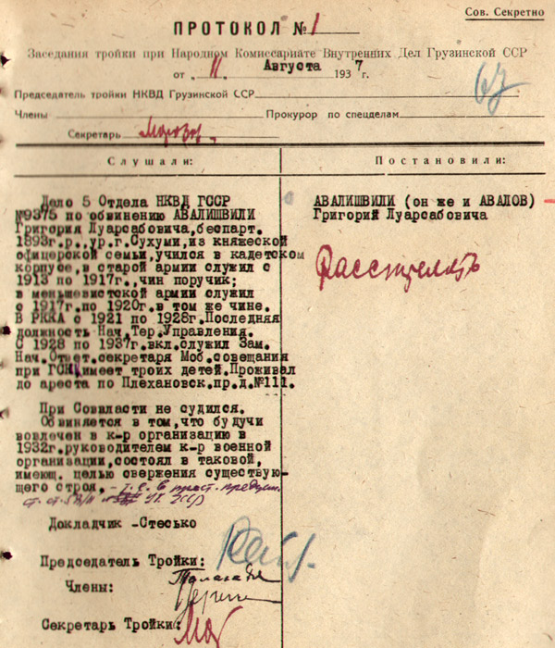
The Most Important Collections Preserved in the MIA Archive of Georgia
Documents and materials on repressions, deportations, and executions at different times: minutes, so called Troika protocols, investigative materials, etc.

Slide 16
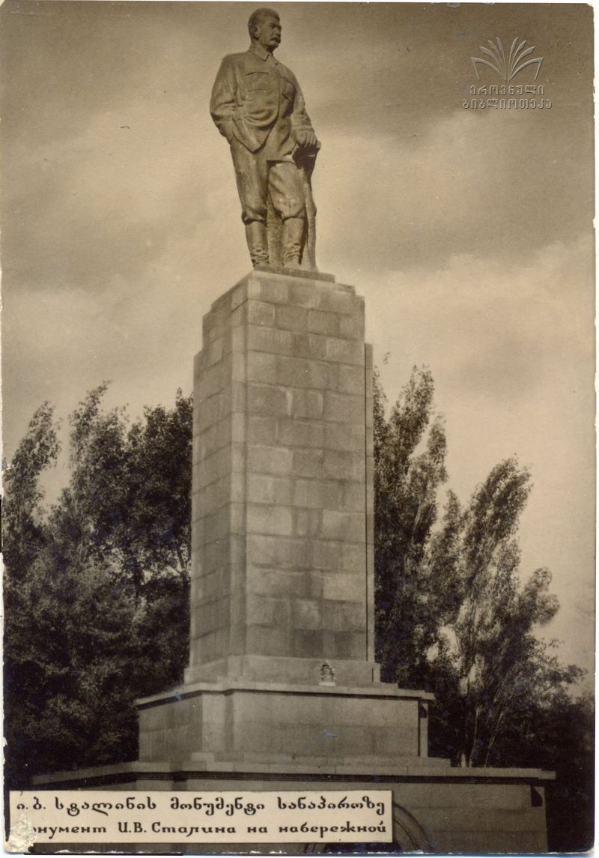
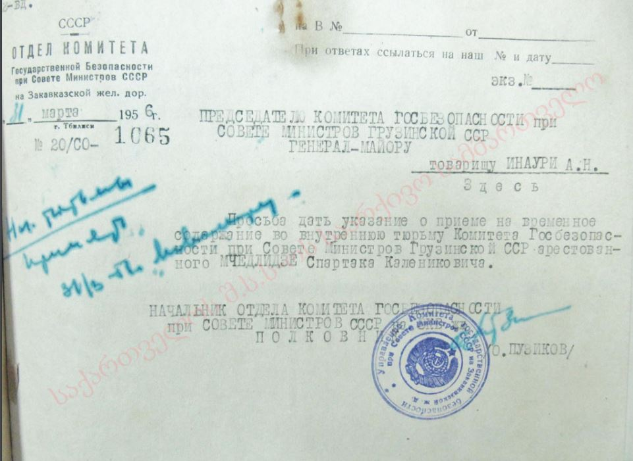
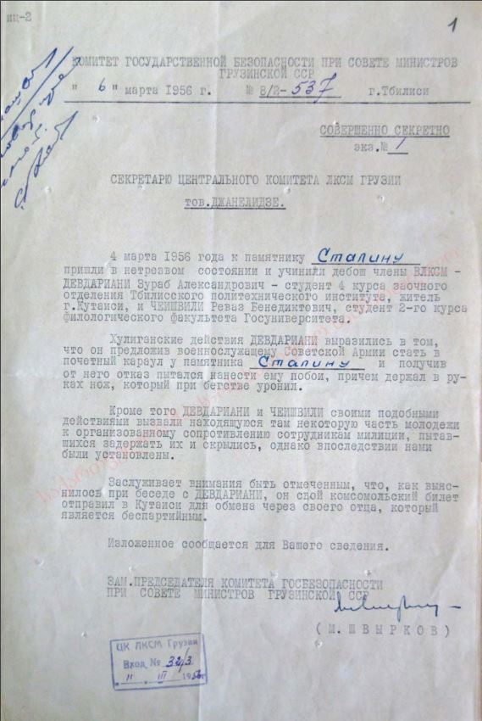
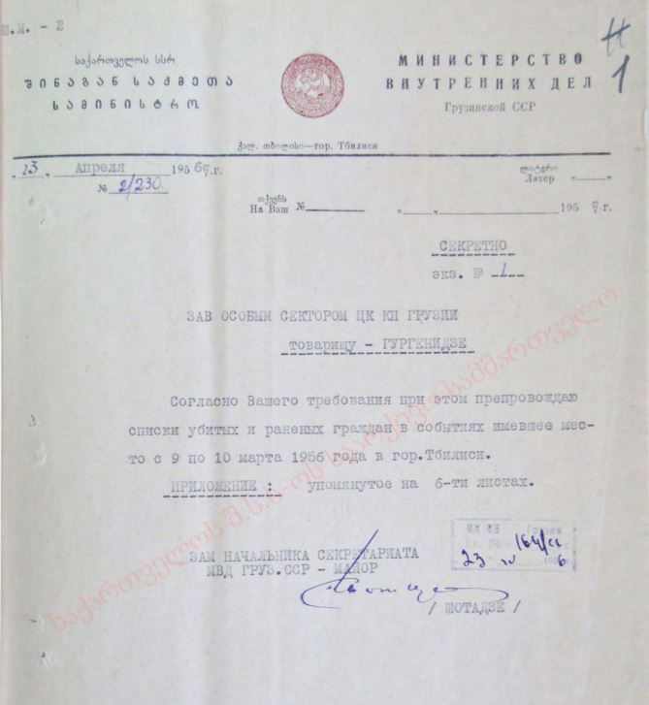
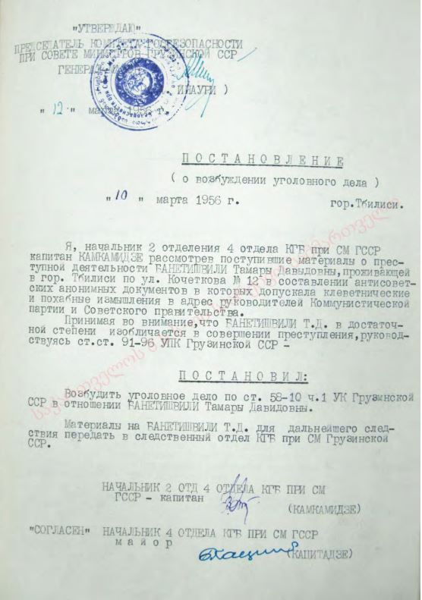
Documents concerning the events of March 1956, also known as the 1956 Tbilisi riots or 9 March massacre - the center of the protests was the capital of the republic, Tbilisi, where spontaneous rallies to mark the third anniversary of Stalin's death and protest denunciation of Stalin’s cult by Khrushchev quickly evolved into an uncontrollable mass demonstration and rioting and resulted in the death of at least 22 people.

Slide 17
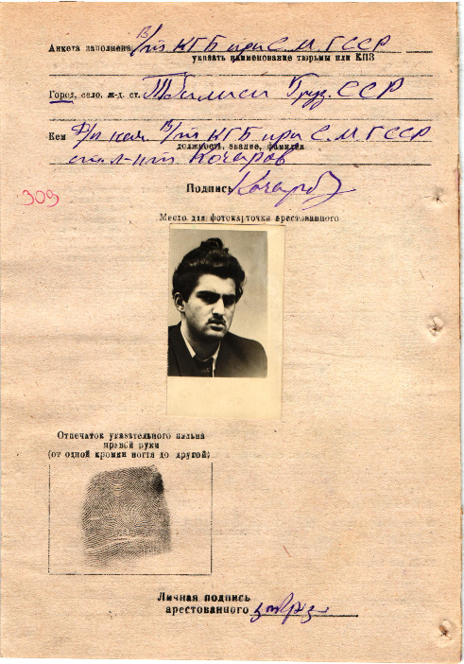
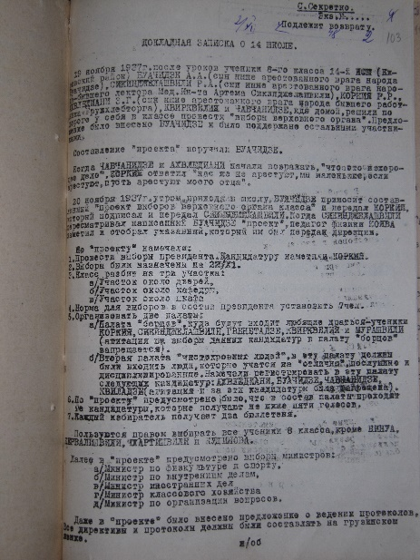
The case of arrested Merab Kostava, later the national hero of Georgia, 1957
The case of the Central Committee of Georgia concerning the behavior of students at one of the schools in Tbilisi and their political education, 1937
Proposal on the erection of Stalin’s statue in the center of Tbilisi, 1948
Criminal cases of the dissidents, surveillance and control of citizens
Activities of the Communist Party of Georgia

Slide 18
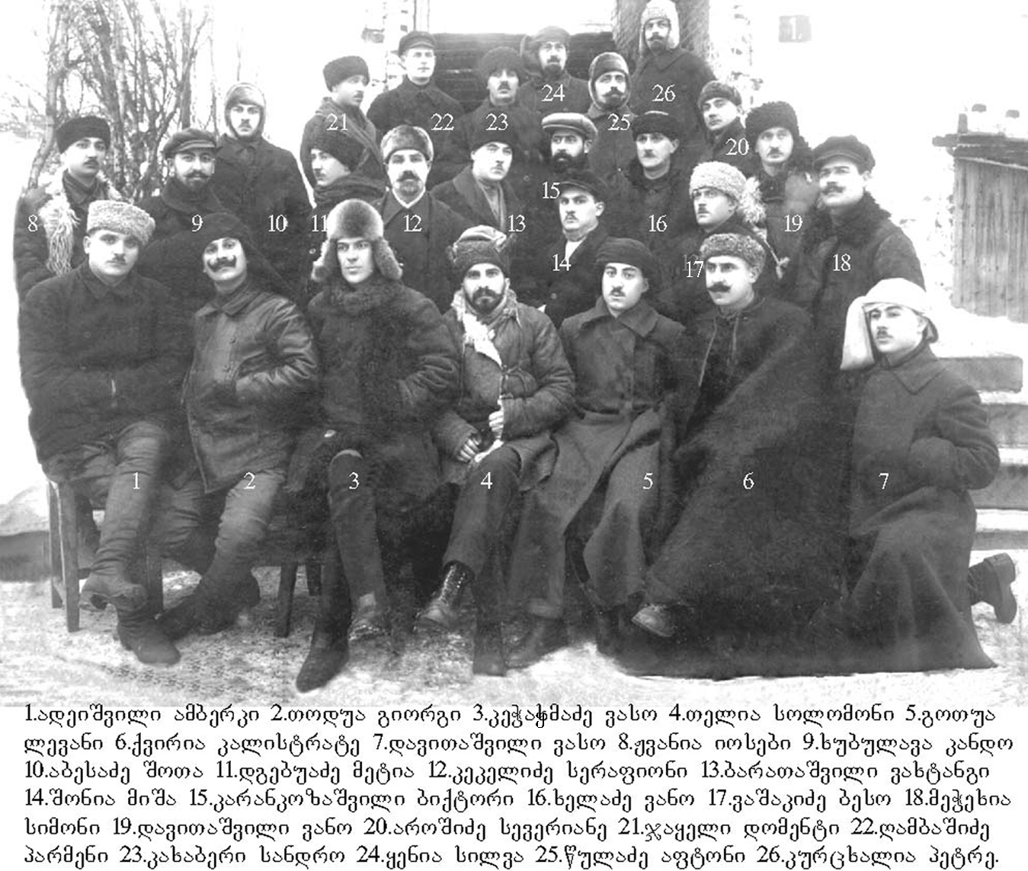
Most Important Collections Preserved in the MIA Archive (former KGB Archive) of Georgia
Fond №13, Special Exiles – This fond collects the lists of exiled persons and cases of “special exile” from 1941 to 1951. Exiles were resettled in Central Asia (Uzbekistan, Kazakhstan and Kyrgyzstan) and Siberia. On the basis of the Resolution №744, passed by the USSR Defense Committee on 8 October, 1941, all ethnic Germans were re-settled. On the basis of the Resolution №6279, passed by the USSR Defense Committee on 31 July, 1944, Meskhetians, Azerbaijanis, Kurds, Iezids, Khemshils, Adjarans, Iranians and Turks were re-settled.
On the basis of the Resolution №2214-856, passed by the USSR Council of Ministers on 29 May, 1949, Dashnak, Armenian, Greek and Turkish families were exiled from Georgia.
On the basis of the Resolution №4893-2113б, passed by the USSR Council of Ministers on 29 November, 1951, Georgians (primarily from the Adjara region), Azerbaijanis (the relatives of émigrés) and former prisoners of war and their families were re-settled.
Resettled Georgians in the Solovki prison camp, 1920’s

Slide 19
Most important collections preserved at the MIA Archive of Georgia (Communist Party Archive)
Fond №1, Special Folders - This fond consists of “Special Folders” (1921-1990) , resolutions passed by the Central Committee of the Communist Party of Georgia. Noteworthy topics in these documents include the Trotskyites, the Great Purge of 1937-1938, Georgian national legions in Germany during the Second World War and the events of 9 March, 1956, in Tbilisi.
Fond №8, The Party History Institute - Memoirs of well-known Georgian Bolsheviks, the establishment of the Georgian social-democratic organizations, the Bolshevik-Menshevik split, opposition to the Tsarist Caucasian Administration, the Civil War and Stalin. This fond also contains documents about the First and Second Revolutions in pre-Soviet Russia (1905-1907 and 1917), the anti-Bolshevik uprising of the Democratic Republic of Georgia, and Georgia’s subsequent invasion by the Red Army.
Fond №13, Transcaucasia Regional Committee of the Communist Party of Russia (1922-1937) - This fond is particularly important, because it consists of presidium, plenum and secretariat protocols of the Transcaucasia Regional Committee of the Russian Soviet Federative Socialist Republic (RSFSR), and stenographic records from Communist organization meetings of Armenian, Georgian and Azerbaijan SSR. Documents concerning the Transcaucasia Bolsheviks’ fight against Mensheviks (Georgia), Dashnaks (Armenia) and Musavats (Azerbaijan) are of a special interest.
Fond №14, Central Committee of the Communist Party of Georgia (1921-1991) - This is the largest fond, and arguably the most valuable. It consists of presidium, plenum and secretariat protocols of the Central Committee of the Communist Party, as well as stenographic accounts and reports concerning Georgia and its various regions. The fond includes materials concerning the Autonomous Republics of Abkhazia, Adjara and South Ossetia. This fond also holds materials on anti-Soviet activities, dissident organizations, 9 April 1989, Abkhazia and South Ossetia, and intra-Party conflicts.

Slide 20
Legislative Regulations on Access to Archives
The main archival law of Georgia is – “On the National Archival Fund and the National Archives”
According to the law of Georgia “On Personal Data Protection” – archival documents containing personal data can be declassified in 75 years after the creation of documents* or 30 years after the death of a person**
*Despite this record of the legislation, all funds and documents kept in the archives of the Ministry of Internal Affairs are open on the basis of the special order of the Minister of Internal Affairs. The National Archives strictly adheres to the law On Personal Data Protection, and researchers practically have no opportunity to read new documents for 75 years.
**The National Archives asks researchers to present death certificates of a person indicated in archival documents. Sometimes, a number of persons mentioned in archival documents is several thousand and researchers are unable to present such certificates.

Slide 21
Arrangement of Documents in Georgian Archives
The cases are located in the archives of Georgia as follows: Fonds, Inventory, File (Geo: ფონდი, აღწერა, საქმე; Rus: Фонд, Опись, Дело).
The system established in the Soviet Union, according to which the documents of the Archives of Georgia are described, did not provide a description of the individual documents (item). For this, the documents are thematically combined in files (except for the ancient manuscripts) that may consist from 1 to several hundred pages.
No ISAD(G) (General International Standard Archival Description) is implemented in any of the archives.

Slide 22
Finding Aid Documents
At the MIA archives (former KGB archive), it is possible to use the electronic catalogue of the repressed persons. The search engine gives links to available archival documents about a particular person. Generally, these documents are scanned and linked in the catalogue, which makes work easier and faster.
The National Archives of Georgia and other archives (Manuscript Center, Archives of Adjara, etc.) have not implemented the search engine and research is being carried out using the printed finding aid books. Also, most of these finding aids were created during the Soviet era, in the 50s and 60s, and do not meet modern standards.

Slide 23
Reading Room of the National Archives
The reading hall of the National Archive is located on the central district of Tbilisi. It provides service for Tbilisi central archives (Historical, Contemporary, Film-Photo-Audio). Kutaisi central archive also has a reading room.
The reading rooms are open from Monday to Friday, 09:30 AM to 17:00 PM, except for the weekends (Saturday and Sunday and the holidays defined by the Article 20 of the Labor Code). The reading room is closed from August 1 till September 1, annually.
To be granted access, substantiation of research objectives and indication of the chronological frame of the research is required. Therefore, if a researcher needs to study the materials of different periods, he/she will need to fill in the form and go through the admission procedures several times.
Access to the reading room is granted in 5 working days after submitting the form, but the practice shows that it can also be granted earlier.

Slide 24
Reading Rooms of the MIA Archive
The MIA Archive has two reading rooms: one in the Security Archive, and another in the Party Archive, which is located in the outskirts of Tbilisi but it is accessible via Metro and public transport.
Opening hours: 11:00 a.m. - 18:00 p.m. except for weekends (Saturday and Sunday and the holidays defined by the Article 20 of the Labor Code).
Access to the reading room is granted in one working day after submitting the form.
In the MIA Archives of Georgia (former KGB archive), the reading hall is merged with the offices of employees, which creates particular discomfort.

Slide 25
Remote and Online Services in Archives
Researcher can be granted access to the reading halls of the National and MIA archives through filling special forms online.
The National Archive provides researchers with online finding aid: scanned finding aid documents are available on the website. Similar practice is implemented in the Communist Party Archive (MIA Archives). The former KGB archive (MIA Archives) has no similar practice and researchers can access finding aid documents and the search engine only at place.
There are no archival files on the websites of archives. Sometimes, archival items and articles based on archival documents, exhibitions and other materials are published for PR purposes, which in fact, cannot be considered as an online access to files.

Slide 26
Institute for Development of Freedom of Information (IDFI) has been advocating for the openness of state archives for many years.
The price for copying 1 page is 2.5-3 GEL ($1).
In 2019, the Parliament of Georgia discussed the legislative proposal on the amendments in the Law on National Archival Fund and National Archives and the Law on Personal Data Protection submitted by IDFI. The legislative proposal envisioned amendments in several directions, including photocopying. The Parliament rejected the legislative amendments.

Slide 27
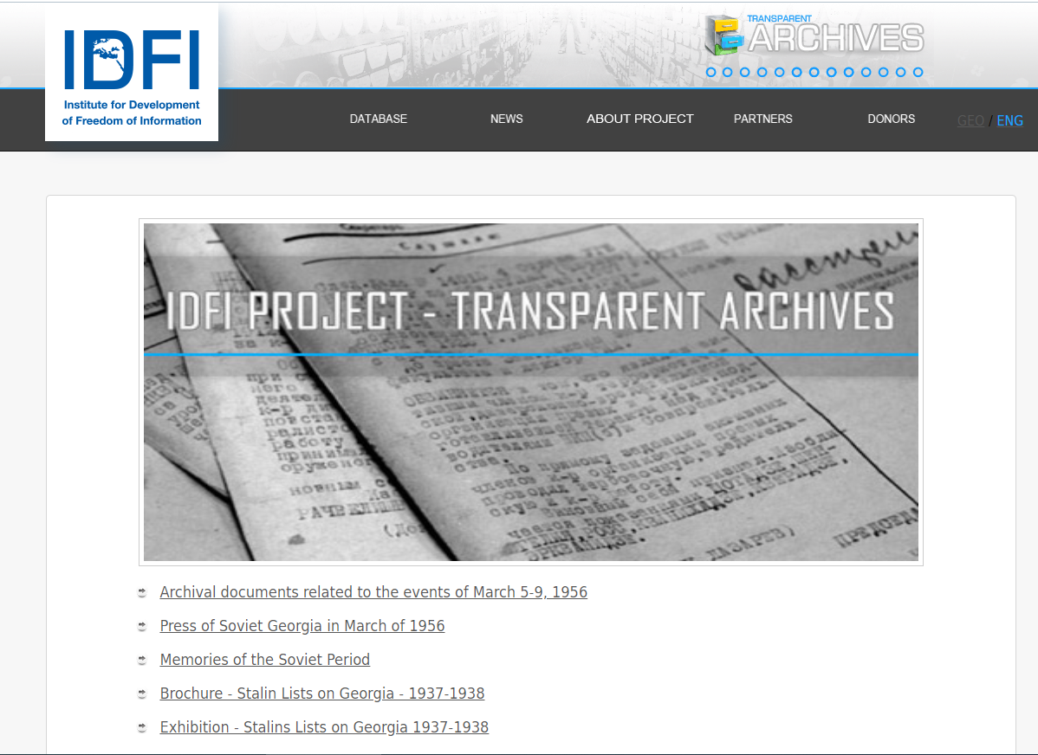
Transparent Archives Page of IDFI
https://www.idfi.ge/archive/index.php?cat=database&lang=en
Collection of archival documents
Exhibitions and memories
Articles and Research
Memory Studies

Slide 28
Stalin’s Lists on Georgia
The Stalin’s Lists Project is a bi-lingual (Georgian and Russian) database on information on 3600 persons who were repressed by Stalin’s direct order in Georgia in 1937-1938. This database presented the unique documental and photo materials describing the tragic events developed in Georgia in 1937-1938. These materials have been searched and found by IDFI in the Archives of the Ministry of Internal Affairs, the Society “Memorial of Georgia”, as well as in the families of the repressed people. It was the first time when the broader society was given opportunity to become familiar with the materials about the victims of repressions and to create impression about the tragic events of 1937-1938. During these years more than 3600 people have been executed by the decisions of the members of Politbureau and Stalin himself. 3100 of them were condemned to the highest measure of punishment – shooting.

Slide 29
The Open-Archives Initiative and Project
The Open-Archives is the Institute for Development of Freedom of Information (IDFI)’s project that started in 2017 with the support of the Open Society Institute - Budapest Foundation (OSI).
Within the frames of the project, a methodology for evaluating the openness of state archives was created and 36 state archives of 18 former Soviet and Eastern European countries were evaluated - 2 state archives in each country.

Slide 30
Evaluation Methodology of The Open-Archives project
The methodology is composed of 86 indicators, each of which is granted different weight and index of social importance.
The indicators are divided into five groups (benchmark indicators) that represent the key characteristics of a well-functioning, open archive. These groups are:
1. The legislative framework: 1.1 General archival legislation; 1.2 Other legislation referring to FOI and archives; 1.3 Archival services;
2. Website: Archive websites and online services;
3. Reading room: services and procedures for the researchers working in the archives.
The selection of indicators for the methodology was largely based on the principles of access to archives adopted by the International Council on Archives (ICA).
The participants fill in the evaluation forms online, on the website: www.open-archives.org
According to the research, Georgia holds 8th place among 18 countries and, in total, the country has scored 70.99%.

Slide 31
The Results of Evaluation
Based on the results of evaluation, received from international partners, the ranking of the openness of the archives is updated on www.open-archives.org
The results are represented in two ways:
1. Results by separate state archives
2. Overall results of the countries
Also, IDFI publishes a report, which includes the analysis of the results of evaluation, the best and worst international practices and recommendations for the state archives for enhancing the accessibility of archival materials.
The full report can be found here - http://open-archives.org/en/newsblogs/interestingnews/36

Slide 32
The results and findings of the study are sent to the relevant state archives and they can, accordingly, plan to address the weaknesses that they have both in legislation and in practice.
Research is also important for researchers who are planning to work in the archives of a former Soviet countries for the first time.
You can find the research methodology, information about partners, rating of particular countries and state archives and various materials created within the frame of the project on this portal - http://open-archives.org/

Slide 33
Thank you!
Giorgi Kldiashvili (Mr.)
Executive Director of the
Institute for Development of
Freedom of Information
Address: 20, Shevchenko Street, Tbilisi, 0108, Georgia.
Contact: Tel (office): +995 322 921514 | Tel (mob): +995 599770100
Web: www.idfi.ge
Skype: giorgi.kldiashvili

